Slide 1
ECEN 150 Circuit Analysis I
Basic Circuit Laws.

Slide 2
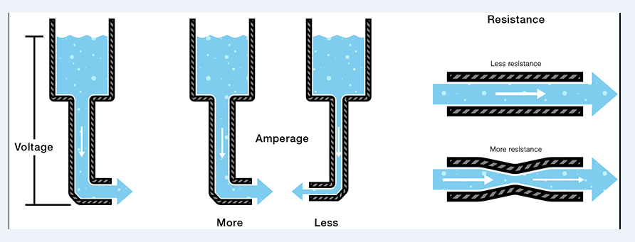
Water Analogy for Electricity
Voltage → Informally electrical pressure, (Volts - V). Analogous to water pressure.
Current → Flow of charge, (Amps - I). Analogous to water flow.
Resistance → Opposition to Current flow, (Ohms - Ω). Analogous to a constriction in a water pipe.
Notes:
https://learn.sparkfun.com/tutorials/transistors/extending-the-water-analogy

Slide 3
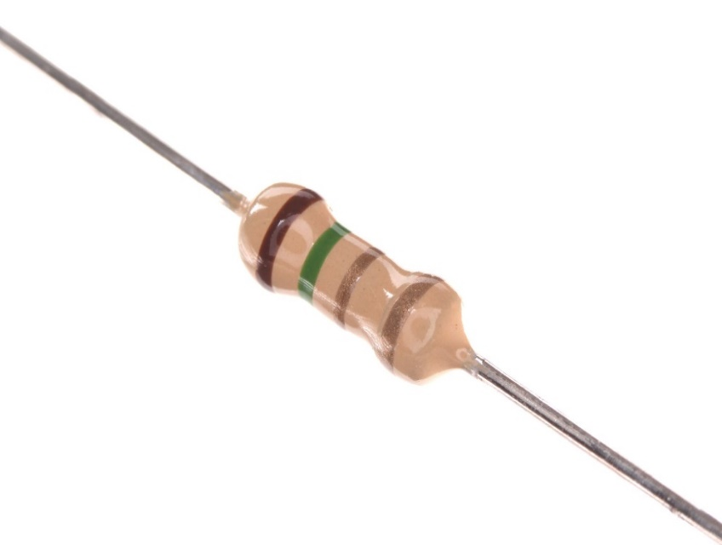
Resistors
Resistors are a simple and common electrical component.
Resistors oppose current flow, i.e. they provide resistance to current flow.
Resistors dissipate (absorb) power, converting electrical energy into heat.
Resistance measured in units of ohms (Ω).
Standard ¼ Watt Resistor
Circuit Symbol
R1 – Unique Name
Resistance Value
Example Resistance Value = 1 kΩ, i.e. 1000 Ω.
Notes:
https://commons.wikimedia.org/wiki/File:1.5_ohm_5%25_axial_resistor.jpg

Slide 4
Conductance - G
Resistance → Opposition to Current flow, (Ohms - Ω).
Conductance → Ease in which a conductor or resistor will pass current. Opposite of opposition.
Current taking the path of least resistance can be re-stated as current takes the path of most conductance.
Conductance G = 1/R in units of Siemens.
A 100 Ω resistor has a conductance of 10 mS.
Using conductance instead of resistance can simplify parallel circuit calculations.

Slide 5
Ohm’s Law
Ohm’s Law Triangle
v = iR
i = v/R
R = v/i
Knowing 2 out of 3 enables us to solve for the unknown quantity.
v
i
R
Notes:
Graphic by BYU-Idaho Campus Curriculum Development in Illustrator

Slide 6
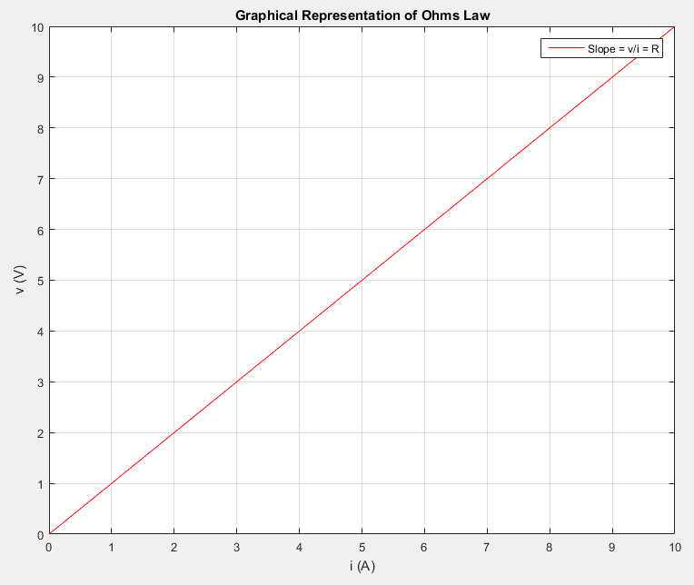
Ohm’s Law Graphically
Constant slope of the v versus i for a linear resistor, which means that the resistance does not change with applied voltage.
Standard resistors are linear elements.
Slope of graph below equal to R = v/i.
Notes:
6
Image from instructor

Slide 7
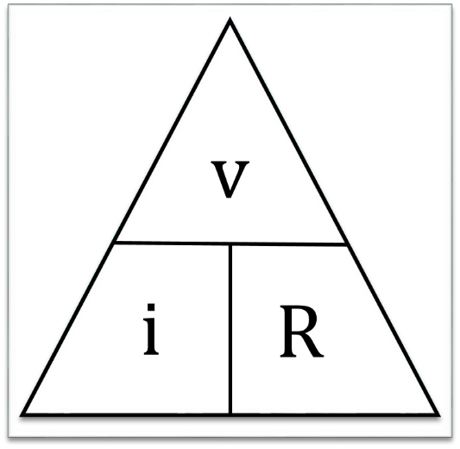
Ohm’s Law Examples
1. What is the current flowing through a
10 Ω resistor with 1 V across it?
i = v/R = (1 V)/(10 Ω) = 0.1 A.
2. What is the voltage across a 10 Ω resistor that has 1 A of current flowing through it?
v = iR = (1 A)(10 Ω) = 10 V.
3. What is the resistance of a light bulb that has 6 V across it with 0.5 A of current flowing through it?
R = v/i = (6 V)/(0.5 A) = 12 Ω.
4. If you double the voltage across a given resistor, by what factor would the current increase?
Factor of 2, since current would double also.
Poll Questions

Slide 8
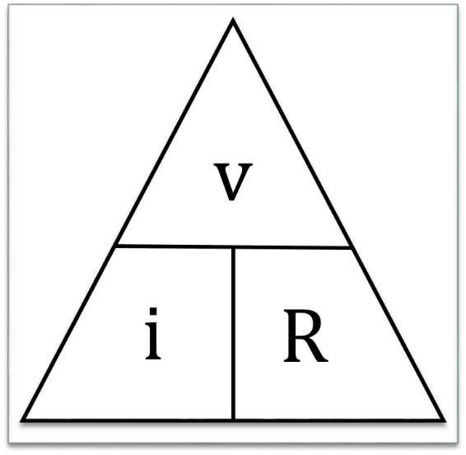
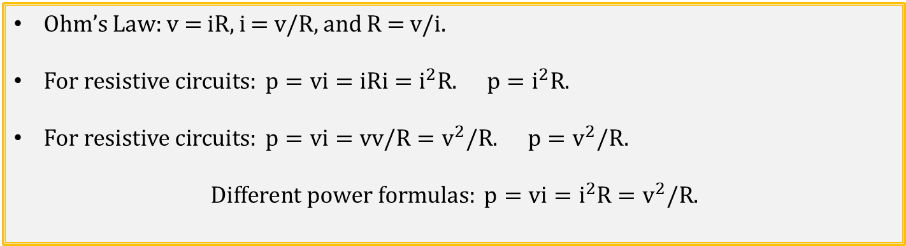
Ohm’s Law and Power
Ohm’s Law: v = iR, i = v/R, and R = v/i.
$For resistive circuits: p=vi=iRi=i^{2}R. p=i^{2}R.$
$For resistive circuits: p=vi=vv/R=v^{2}/R. p=v^{2}/R.$
$$Different power formulas: p=vi=i^{2}R=v^{2}/R.$$
Notes:
Image by instructor

Slide 9
Significan Figures
While on a computer 6 = 6.0 = 6.00, from an accuracy point of view the more significant figures, the better.
The single significant figure 6 means that the actual number could range from 5.9 to 6.4.
The two significant figure 6.0 means that the actual number could range from 5.95 to 6.04.
The three significant figure 6.00 means that the actual number could range from 5.995 to 6.004.
In this course, 3 significant figures are usually recommended for recording the results of numeric calculations.
Notes:
Image by instructor

Slide 10
Circuit Terminology
Circuit comes from Latin, meaning to “go around”.
Open Circuit indicates that there is a gap or opening in the circuit so that no current flows. The gap or opening may be an open switch.
Closed circuit indicates that there is a complete path for current to flow around the circuit. Any switches in the circuit must be closed to form a closed circuit.
Short Circuit indicates that a very low resistance path is connected across an element, resulting in the current bypassing the element that is shorted, since current flows through the path of least resistance.
Branch – A single element, such as a voltage source or resistor.
Node – A electrical connection with negligible resistance between two or more elements (branches). Low-resistance wires form nodes in practical circuits
Loop – Any closed path in a circuit.
Mesh – A loop that does not contain any other loop within it. (Window pane).
Series connected elements exclusively share a single node, and therefore carry the same current. End-to-end series connected elements have the same current flowing through them.
Parallel connected elements are connected across the same two nodes. Therefore parallel connected elements have the same voltage across them.
Notes:
Image by instructor

Slide 11
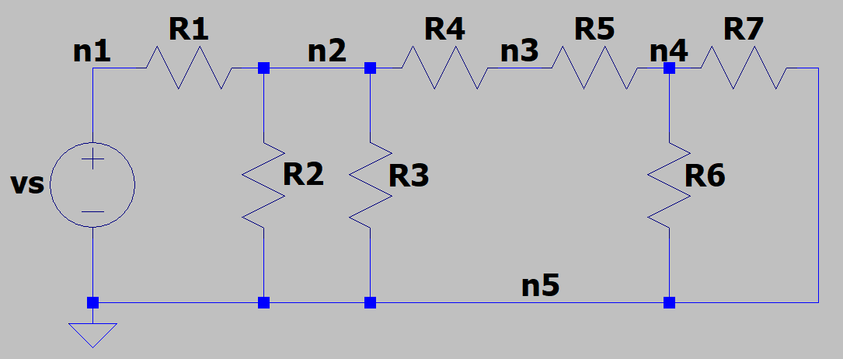
Series and Parallel Resistors
Which elements are connected in series in the circuit below?
v_{s} and R1 are connected in series as they exclusively share node n1.
R4 and R5 are connected in series as they exclusively share node n3.
Which elements are connected in parallel in the adjacent circuit?
R2 and R3 are in parallel as they share connections to n2 and n5.
R6 and R7 are in parallel as they share connections to n4 and n5.
Notes:
Image by instructor

Slide 12
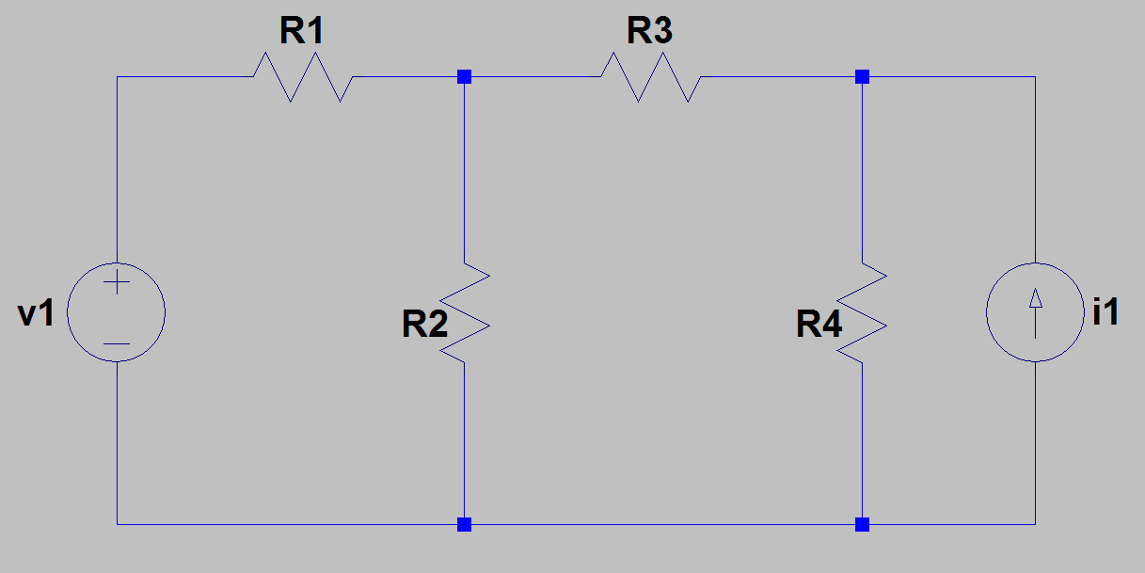
Nodes, Branches, Loops and Meshes
How many nodes, loops, meshes and branches does the circuit below contain?
The circuit below has 4 nodes, 6 loops, 3 meshes and 6 branches.
Which elements are connected in series in the circuit below?
v1 & R1 are connected in series as they share a single node, i.e. n1.
Which elements are connected in parallel in the circuit below?
R4 & i1 are connected in parallel as they are connected to the same two nodes n3 and n4.
Check: (Eq. 2.12) branches = meshes + nodes – 1 = 3 + 4 – 1 = 6. Branches = 6.
n1
n2
n3
Loops: v1→R1→R2, R2→R3→R4, R4→i1, v1→R1→R3→R4, v1→R1→R3→i1, R2→R3→i1.
Meshes: v1→R1→R2, R2→R3→R4, R4→i1.
n4
Notes:
Image by instructor

Slide 13
Notational Summary
Capital (upper case) letters generally used for constant (time invariant) quantities like DC voltage and DC current sources.
Lower case letters are used for time varying quantities, including AC voltages and current along with transients.
Lower case letters are considered more general than upper case letters and so are often used when results are valid for either time varying and time invariant quantities, as is the case with our text.
V, v, or v(t) used for voltage. (Some disciplines use E instead of V for dc voltage).
I, i, or i(t) used for current.
Q, q or q(t) used for charge.
P, p, or p(t) used for electrical power.
R used for resistance that is independent of time and/or voltage.
Multiplication indicated by VI rather than V·I, as V·I is often used to denote multiplication via the vector dot product.

Slide 14
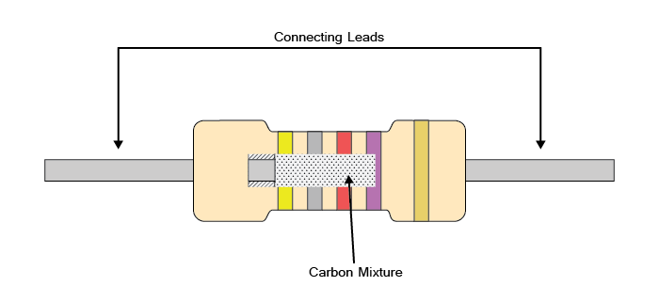
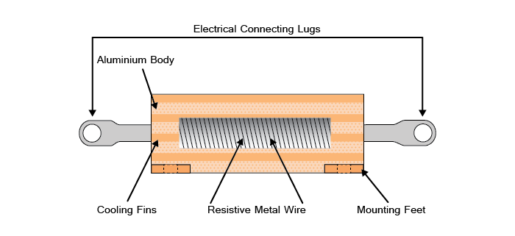
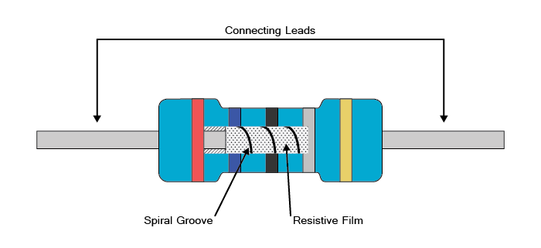
Resistor Examples
Notes:
Graphic by BYU-Idaho Campus Curriculum Development in Illustrator

Slide 15
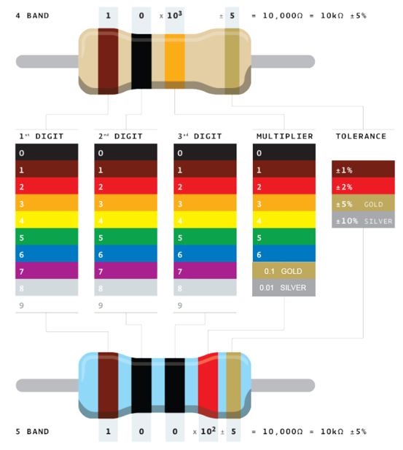
Resistor Color Code
Mnemonic
Better - Black
Be - Brown
Right - Red
Or - Orange
Your - Yellow
Great - Green
Big - Blue
Venture - Violet
Goes - Grey
Wrong - White
By Adim Kassn, https://commons.wikimedia.org/wiki/File:Resistor_color_code.png
Notes:
By Adim Kassn, https://commons.wikimedia.org/wiki/File:Resistor_color_code.png

Slide 16
Resistor 4-Band Color Code Examples
Ex. 1. Brown – Black – Red – Gold.
What is resistor value and tolerance?
10 x 10² = 1000 → 1 kΩ ±5%.
Ex. 2. Red – Red – Black – Gold.
What is resistor value and tolerance?
22 x 10⁰ = 22 → 22 Ω ±5%.
Ex. 3. Red – Violet – Gold – Gold.
What is resistor value and tolerance?
27 x 0.1 = 2.7 → 2.7 Ω ±5%.
By Adim Kassn, https://commons.wikimedia.org/wiki/File:Resistor_color_code.png
Notes:
By Adim Kassn, https://commons.wikimedia.org/wiki/File:Resistor_color_code.png

Slide 17
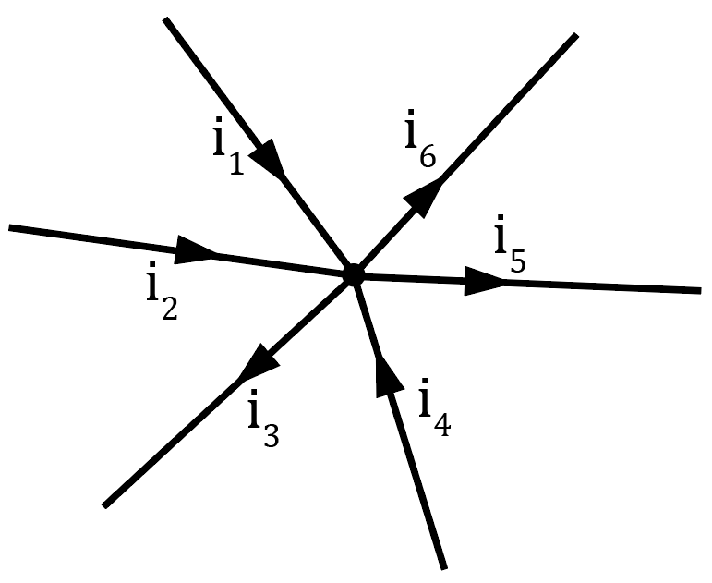
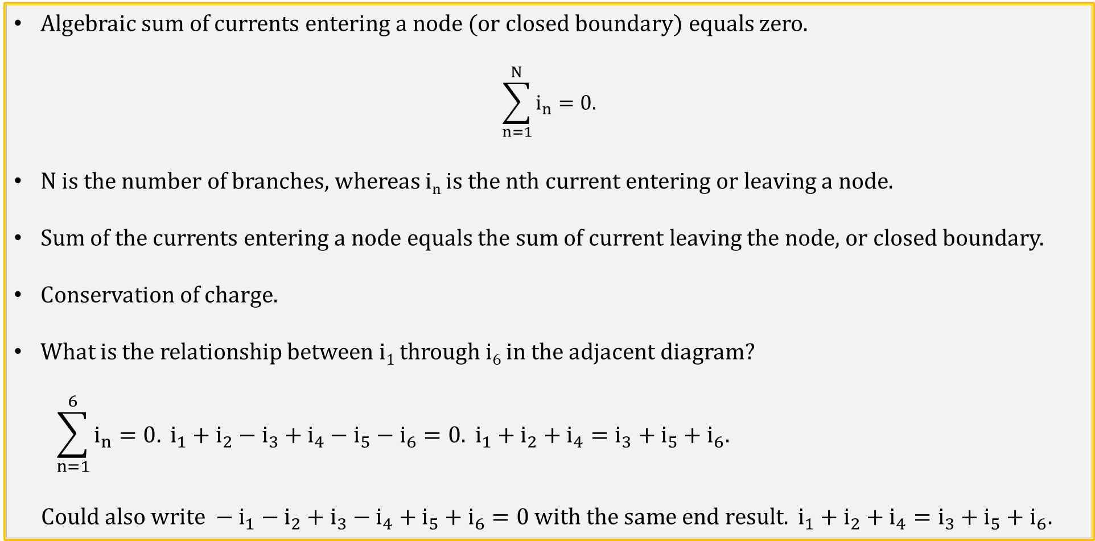
Kirchhoff’s Current Law (KCL)
Algebraic sum of currents entering a node (or closed boundary) equals zero.
$$\sum_{n=1}^{N}{i_{n}=0.}$$
N is the number of branches, whereas i_{n} is the nth current entering or leaving a node.
Sum of the currents entering a node equals the sum of current leaving the node, or closed boundary.
Conservation of charge.
What is the relationship between i₁ through i₆ in the adjacent diagram?
$$\sum_{n=1}^{6}{i_{n}=0.} i_{1}+i_{2}−i_{3}+i_{4}−i_{5}−i_{6}=0. i_{1}+i_{2}+i_{4}=i_{3}+i_{5}+i_{6}.$$
$$Could also write −i_{1}−i_{2}+i_{3}−i_{4}+i_{5}+i_{6}=0 with the same end result. i_{1}+i_{2}+i_{4}=i_{3}+i_{5}+i_{6}.$$
Notes:
Image by instructor

Slide 18
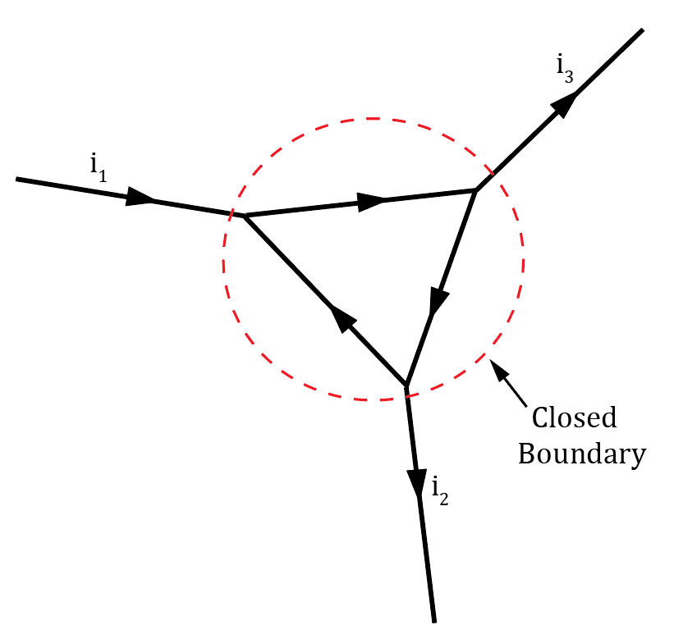
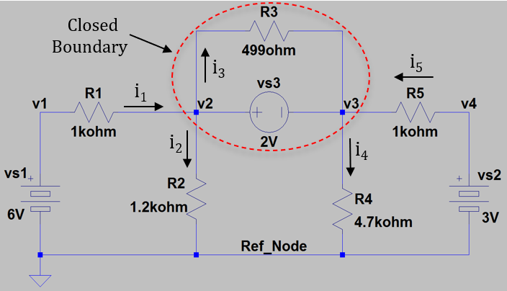
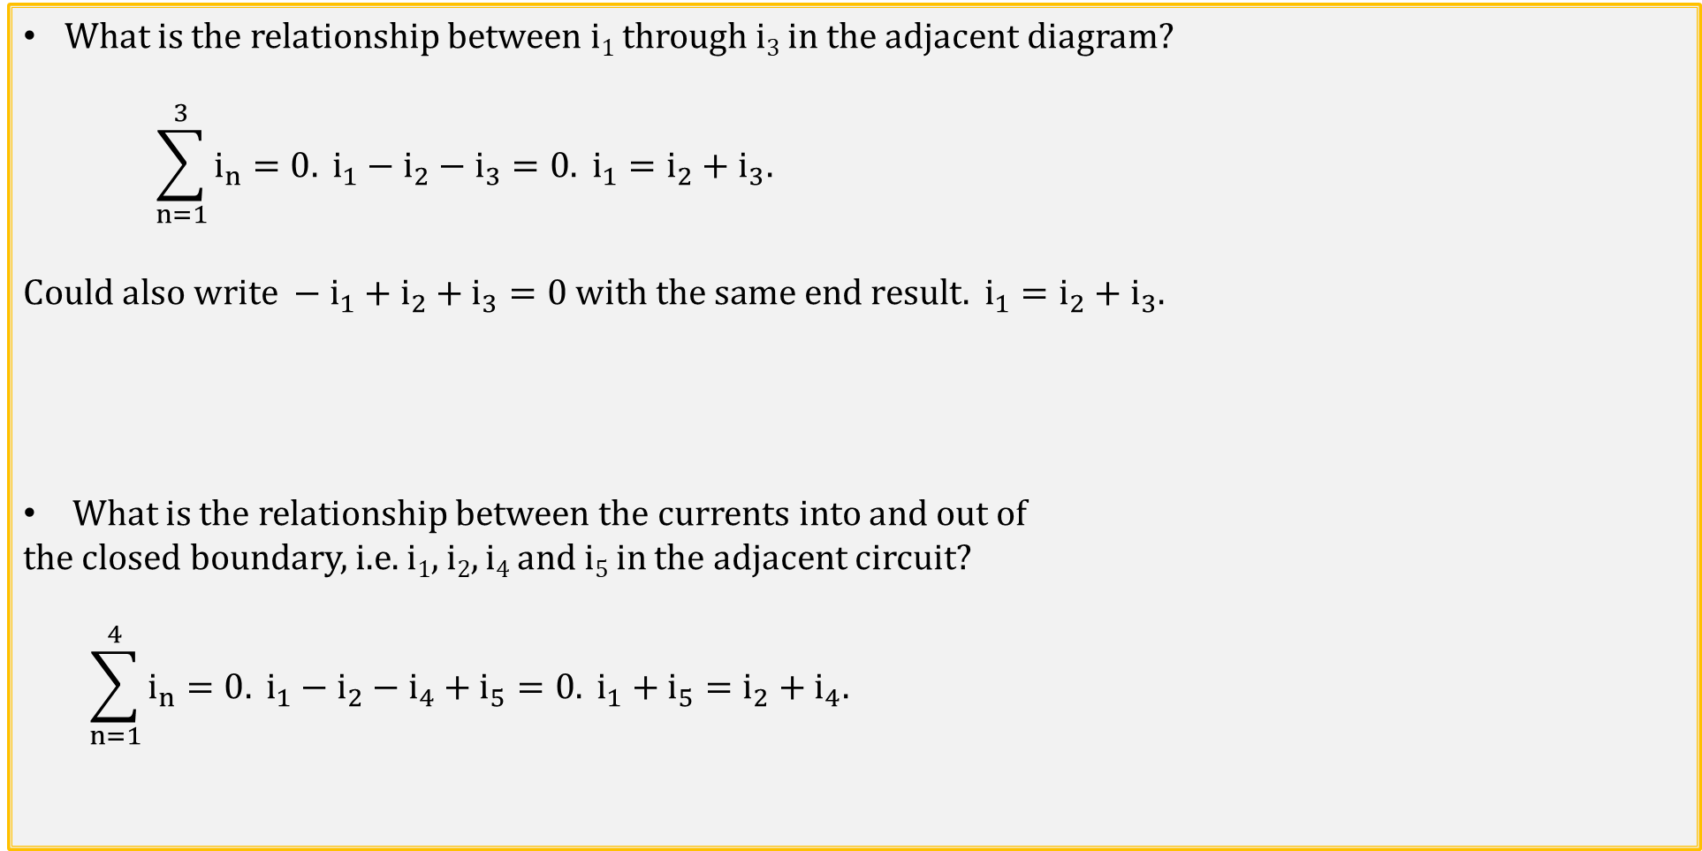
Kirchhoff’s Current Law (KCL) (Continued)
What is the relationship between i₁ through i₃ in the adjacent diagram?
$$\sum_{n=1}^{3}{i_{n}=0.} i_{1}−i_{2}−i_{3}=0. i_{1}=i_{2}+i_{3}.$$
$$Could also write −i_{1}+i_{2}+i_{3}=0 with the same end result. i_{1}=i_{2}+i_{3}.$$
What is the relationship between the currents into and out of
the closed boundary, i.e. i₁, i₂, i₄ and i₅ in the adjacent circuit?
$$\sum_{n=1}^{4}{i_{n}=0.} i_{1}−i_{2}−i_{4}+i_{5}=0. i_{1}+i_{5}=i_{2}+i_{4}.$$
Notes:
Image by instructor

Slide 19
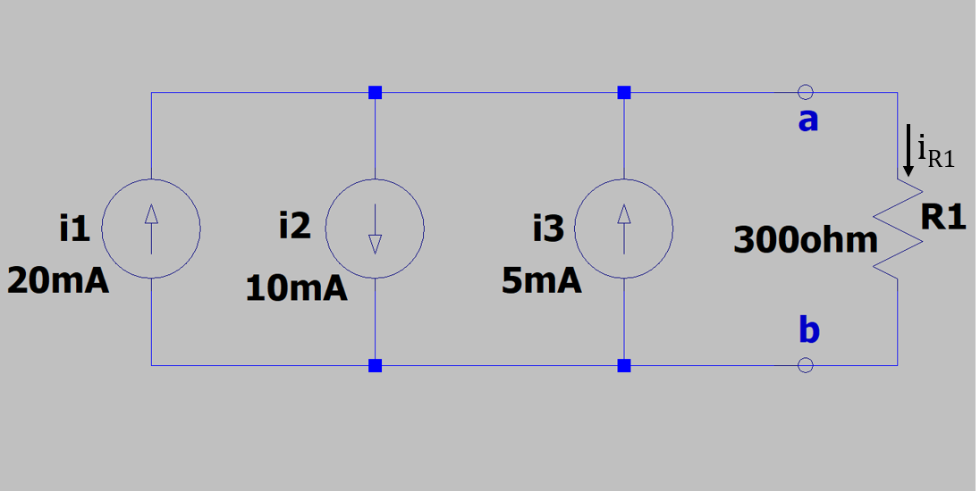
KCL Current Source Example
Node 1
What is the current through resistor R1, i.e., i_{R1},
for the adjacent circuit?
KCL says sum of the currents entering a node
equals the sum of current leaving the node.
KCL: i1 – i2 + i3 - i_{R1} = 0. i1 –i2 + i3 = i_{R1}. i_{R1} = i1 – i2 + i3 = 20 mA – 10 mA + 5 mA = 15 mA. i_{R1} = 15 mA.
What is the voltage across resistor R1?
v_{R1}= (15 mA)(300 Ω) = 4.5 V. Each current source also has 4.5 V across it.
Is the voltage at the a terminal larger or smaller than the voltage at the b terminal?
Since conventional current flows from a to b through resistor R1, the voltage at the a terminal is more positive than the voltage at the b terminal by 4.5 V.
+
_
Node 2
Notes:
Image by instructor

Slide 20
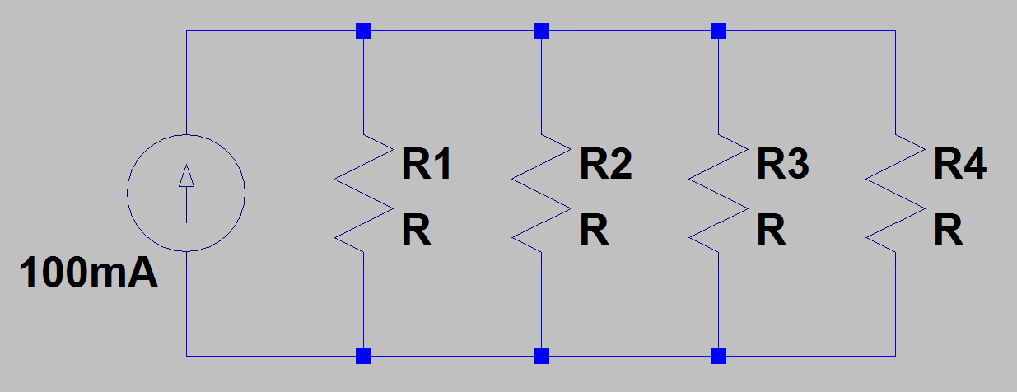
KCL Resistor Example
What is the current flowing through each resistor in the circuit below?
Node – A point of connection between two or
more elements.
Node 1 provides the same voltage to all elements
Connected to it, as does node 2 in the adjacent circuit.
KCL says sum of the currents entering a node equals
equals the sum of current leaving the node.
i_{R1} + i_{R2} + i_{R3} + i_{R4} = 100 mA.
i_{R1} = i_{R2} = i_{R3} = i_{R4} = (100 mA)/4 = 25 mA.
What is the voltage across each resistor?
Unknown without more information, although it is the same for each resistor since they have equal resistance values.
Node 1
Node 2
Poll Questions
Notes:
Image by instructor

Slide 21
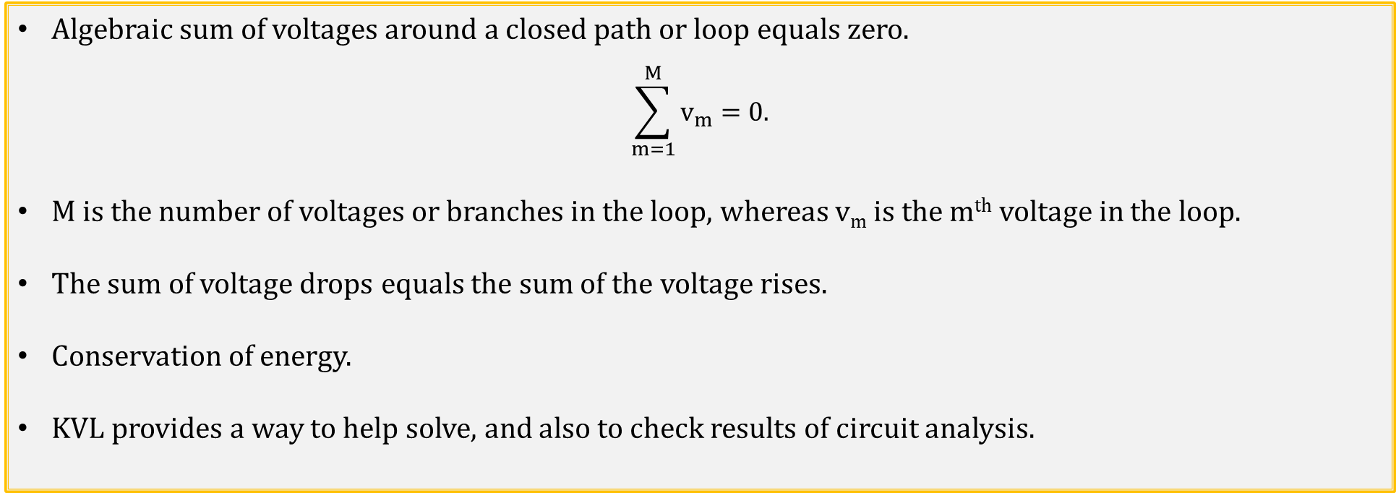
Kirchhoff’s Voltage Law (KVL)
Algebraic sum of voltages around a closed path or loop equals zero.
$$\sum_{m=1}^{M}{v_{m}=0.}$$
M is the number of voltages or branches in the loop, whereas v_{m} is the m^{th} voltage in the loop.
The sum of voltage drops equals the sum of the voltage rises.
Conservation of energy.
KVL provides a way to help solve, and also to check results of circuit analysis.
Notes:
Image by instructor

Slide 22
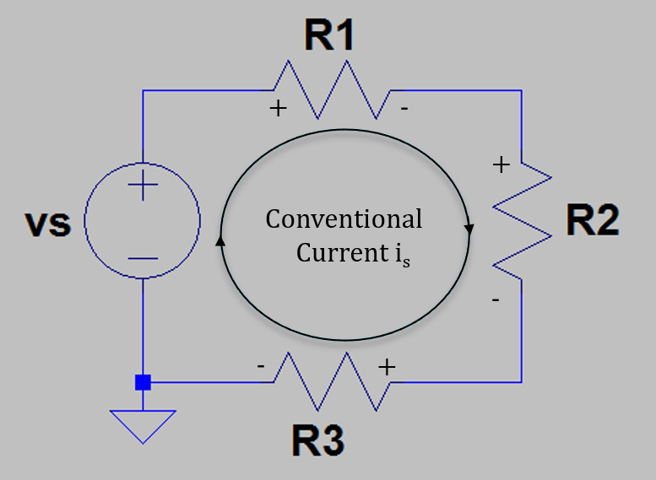
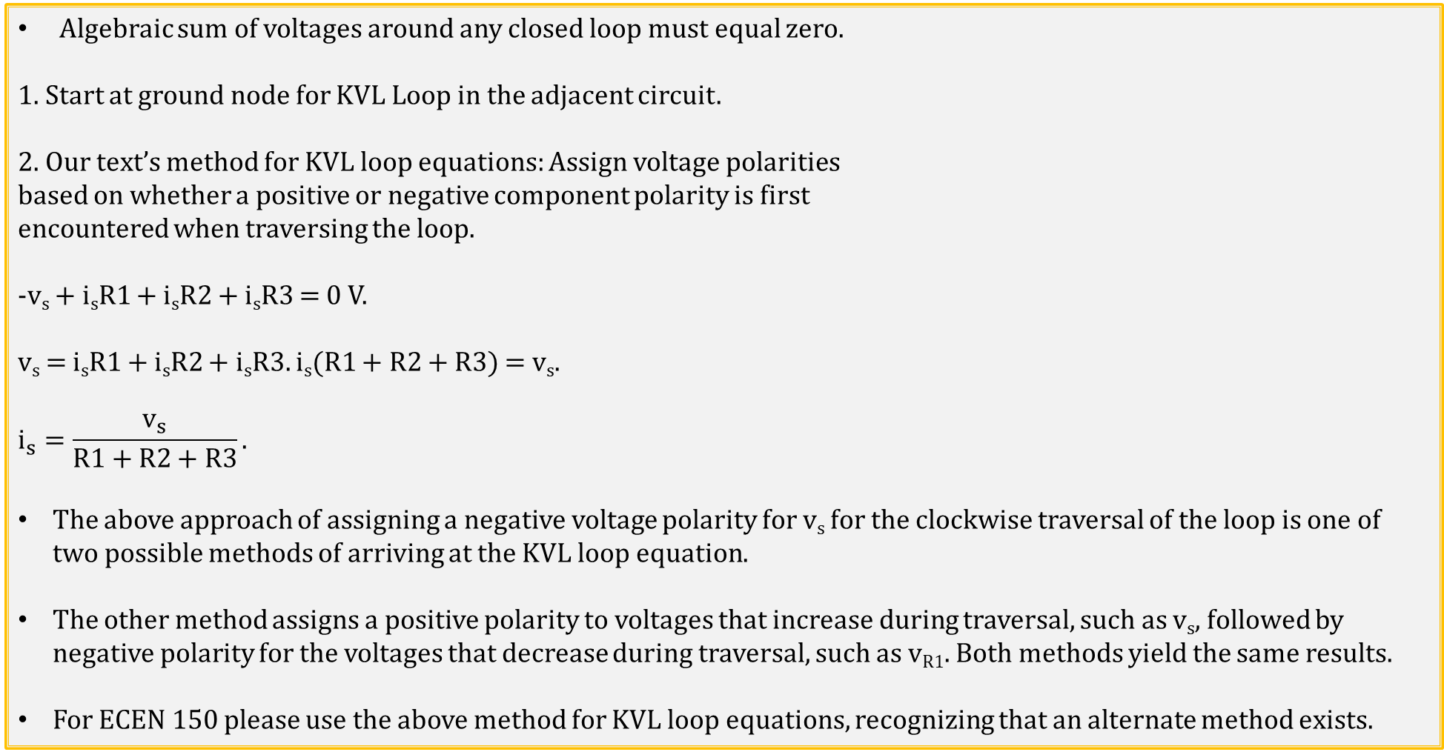
KVL Example 1
Algebraic sum of voltages around any closed loop must equal zero.
1. Start at ground node for KVL Loop in the adjacent circuit.
2. Our text’s method for KVL loop equations: Assign voltage polarities
based on whether a positive or negative component polarity is first
encountered when traversing the loop.
-v_{s} + i_{s}R1 + i_{s}R2 + i_{s}R3 = 0 V.
v_{s} = i_{s}R1 + i_{s}R2 + i_{s}R3. i_{s}(R1 + R2 + R3) = v_{s}.
$$i_{s}=\frac{v_{s}}{R1+R2+R3}.$$
The above approach of assigning a negative voltage polarity for v_{s} for the clockwise traversal of the loop is one of two possible methods of arriving at the KVL loop equation.
The other method assigns a positive polarity to voltages that increase during traversal, such as v_{s}, followed by negative polarity for the voltages that decrease during traversal, such as v_{R1}. Both methods yield the same results.
For ECEN 150 please use the above method for KVL loop equations, recognizing that an alternate method exists.
Notes:
Image by instructor

Slide 23
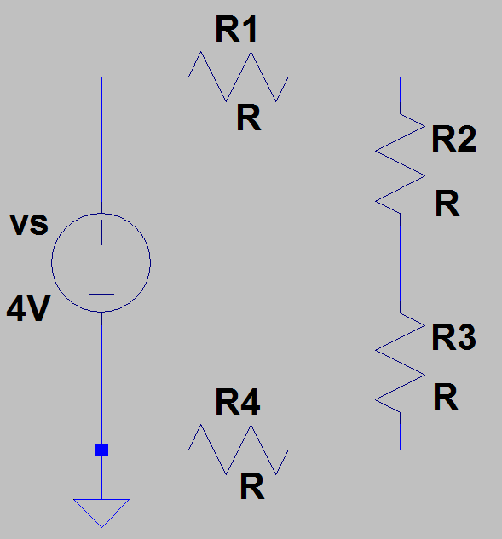
KVL Example 2
What is the voltage drop across each resistor in the series circuit below?
All components of a series circuit share the same current.
Algebraic sum of voltages around a closed loop always equals zero.
-v_{s} + i_{s}R1 + i_{s}R2 + i_{s}R3 + i_{s}R4 = 0 V.
Ohm’s Law tells us that i_{s}R1 = v_{R1}, i_{s}R2 = v_{R2}, i_{s}R3 = v_{R3} and i_{s}R4 = v_{R4}.
Also, v_{R1} + v_{R2} + v_{R3} + v_{R4} = 4 V.
Since all resistors are of equal value R, and they share the same current:
v_{R1} = v_{R2} = v_{R3} = v_{R4} = (4 V)/4 = 1 V.
i_{s}
i_{s}
i_{s}
Notes:
Image by instructor

Slide 24
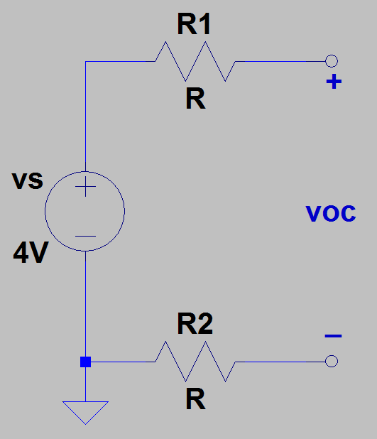
KVL Example 3
What is the open-circuit voltage v_{OC} in the series circuit below?
Algebraic sum of voltages around a closed loop always equals zero.
-v_{s} + i_{s}R1 + v_{oc} + i_{s}R2 = 0 V.
v_{R1} + v_{oc} + v_{R2} = 4 V.
v_{R1} = v_{R2} = 0 V. Why?
All components of a series circuit share the same current.
All components in the above circuit have zero current, because it is an
open circuit, i.e., i_{s} = 0 A.
Voltage can exist across the output terminals of an open circuit without any current flowing, as is the case for a 9 V battery sitting in a drawer or the 120 V ac wall plug.
Open-circuit voltage v_{oc} = 4 V.
For an open-circuit the equivalent resistance is ∞ Ω. i = v/R = 0 A for R = ∞ Ω.
Notes:
Image by instructor

Slide 25
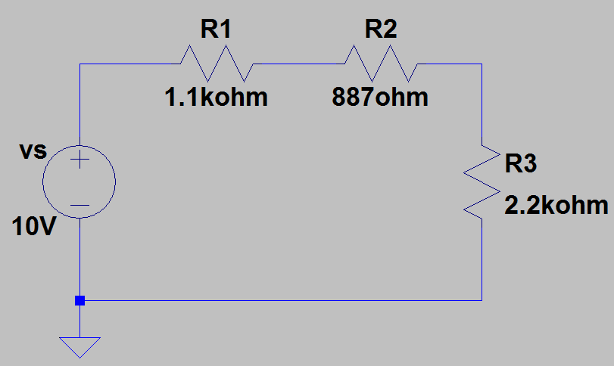
KVL Example 5
Determine the voltages, v_{R1}, v_{R2}, and v_{R3}, along with the powers p_{R1}, p_{R2}, and p_{R3} in the series circuit below.
v_{R1} = i_{s}R1, v_{R2} = i_{s}R2, and v_{R3} = i_{s}R3.
KVL: -v_{s} + v_{R1} + v_{R2} + v_{R3} = 0. v_{s} = v_{R1} + v_{R2} + v_{R3}.
v_{s} = i_{s}R1 + i_{s}R2 + i_{s}R3 = i_{s}(R1 + R2 + R3). v_{s} = i_{s}(R1 + R2 + R3).
i_{s} = v_{s} /(R1 + R2 + R3) = (10 V)/(4.19 kΩ) = 2.39 mA. i_{s} = 2.39 mA.
v_{R1} = i_{s}R1 = (2.39 mA)(1.1 kΩ) = 2.62 V. v_{R2} = i_{s}R2 = (2.39 mA)(887 Ω) = 2.12 V.
v_{R3} = i_{s}R3 = (2.39 mA)(2.2 kΩ) = 5.25 V.
KVL Check: 2.62 V + 2.12 V + 5.25 V = 9.99 V. The lost 0.01 V is simply roundoff error in the calculations.
p_{R1} = i_{s}v_{R1} = (2.39 mA)(2.63 V) = 6.28 mW. p_{R2} = i_{s}v_{R2} = (2.39 mA)(2.12 V) = 5.06 mW.
p_{R3} = i_{s}v_{R3} = (2.39 mA)(5.25 V) = 12.5 mW. p_{R1} + p_{R2} + p_{R3} = 23.8 mW. (Total power dissipated.)
p_{vs} = (10 V)(-2.39 mA) = -23.9 mW (Total power provided using the Passive Sign Convention).
i_{s}
Notes:
Image by instructor

Slide 26
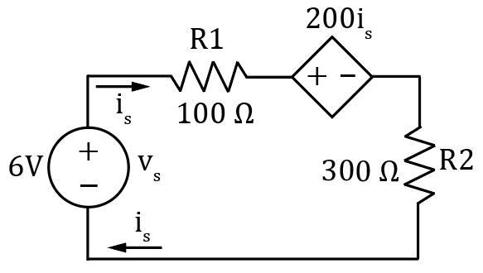
KVL Example 4
Using KVL, determine the current I in the adjacent series circuit.
KVL: -v_{s} + i_{s}R1 + 200i_{s} + i_{s}R2 = 0.
v_{s} = i_{s}(R1 + 200 + R2).
i_{s} = v_{s} /(R1 + 200 + R2) = (6 V)/(600 Ω) = 10 mA. i_{s} = 10 mA.
KVL Check: v_{R1} = i_{s}R1 = (10 mA)(100 Ω) = 1.00 V.
200i_{s} = 200(10 mA) = 2.00 V.
v_{R2} = i_{s}R2 = (10 mA)(300 Ω) = 3.00 V.
KVL Check: 1.00 V + 2.00 V + 3.00 V = 6.00 V = v_{s}.
Notes:
Image by instructor

Slide 27
Series and Parallel Voltage Sources
Series Voltage Sources → Good idea.
Batteries with voltages > 4 V are usually strings of series connected cells.
Parallel Voltage Sources → Beware!
Voltage differences between parallel voltage sources can result in large currents!
Problems can arise when replacing just one of multiple parallel connected batteries because fresh battery will have a larger voltage, resulting in hard work for the fresh battery.
Common parallel battery example is jump starting a car with a dead battery.
Meter leads used in STC 215 would likely be damaged if used to jump start a car.
Jumper cables are designed to handle > 100 A.
Notes:
Image by instructor

Slide 28
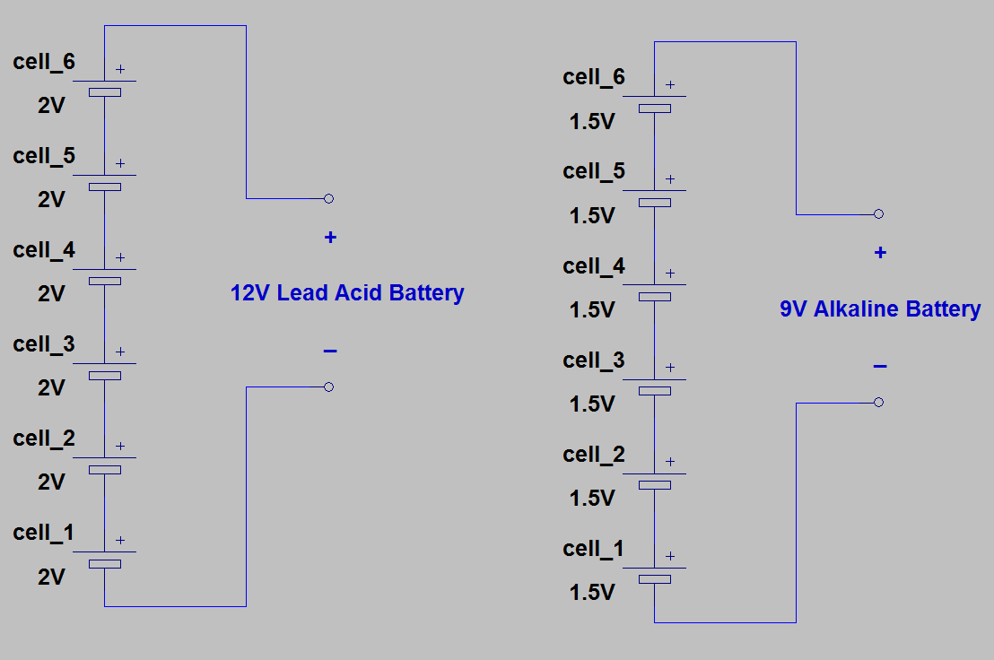
Series Voltage Sources
Series Voltage Sources → Good idea.
Batteries with voltages > 4 V are usually strings of series connected cells.
Notes:
Image by instructor

Slide 29
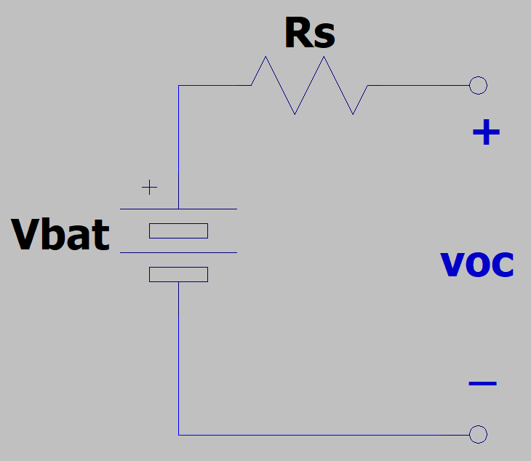
Battery Testers
The terminal voltage of practical batteries decreases with increasing load current.
This is often modeled in circuits by means of a series source resistance R_{s}.
The source resistance R_{s} increases (worsens) as batteries are further discharged.
Heavily discharged batteries can produce the full voltage across the output terminals when they are open-circuited, i.e. no load.
For example, a heavily discharged 9 V alkaline battery will often produce 9 V across the output terminals when disconnected from the device it is intended to provide power for.
Hence good quality battery testers put the batteries under load, which then reduces the output voltage by i_{load}R_{s}.
Notes:
Image by instructor

Slide 30
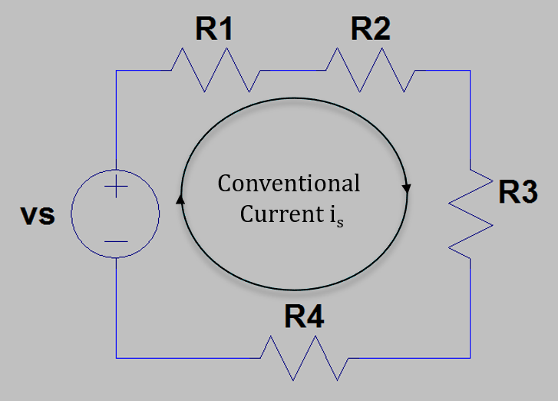
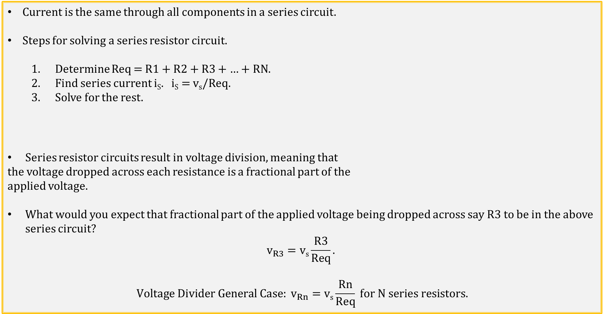
Series Resistor Circuits
Current is the same through all components in a series circuit.
Steps for solving a series resistor circuit.
Determine Req = R1 + R2 + R3 + … + RN.
Find series current i_{S}. i_{S} = v_{s}/Req.
Solve for the rest.
Series resistor circuits result in voltage division, meaning that
the voltage dropped across each resistance is a fractional part of the
applied voltage.
What would you expect that fractional part of the applied voltage being dropped across say R3 to be in the above series circuit?
$$v_{R3}=\text{v}\text{s}\frac{R3}{Req}.$$
$$Voltage Divider General Case: v_{Rn}=\text{v}\text{s}\frac{Rn}{Req} for N series resistors.$$
Notes:
Image by instructor

Slide 31
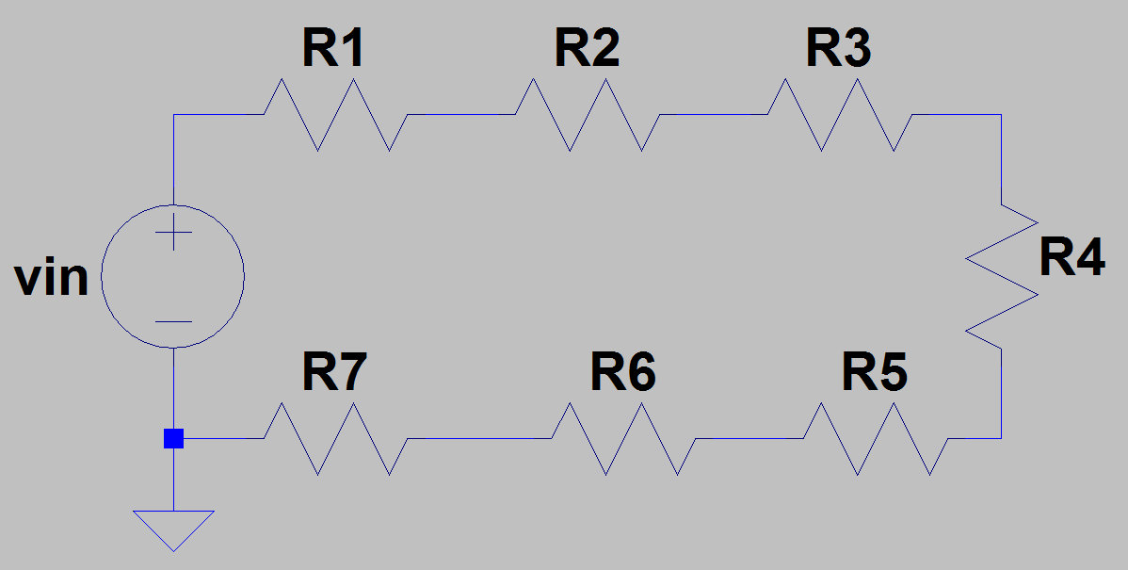
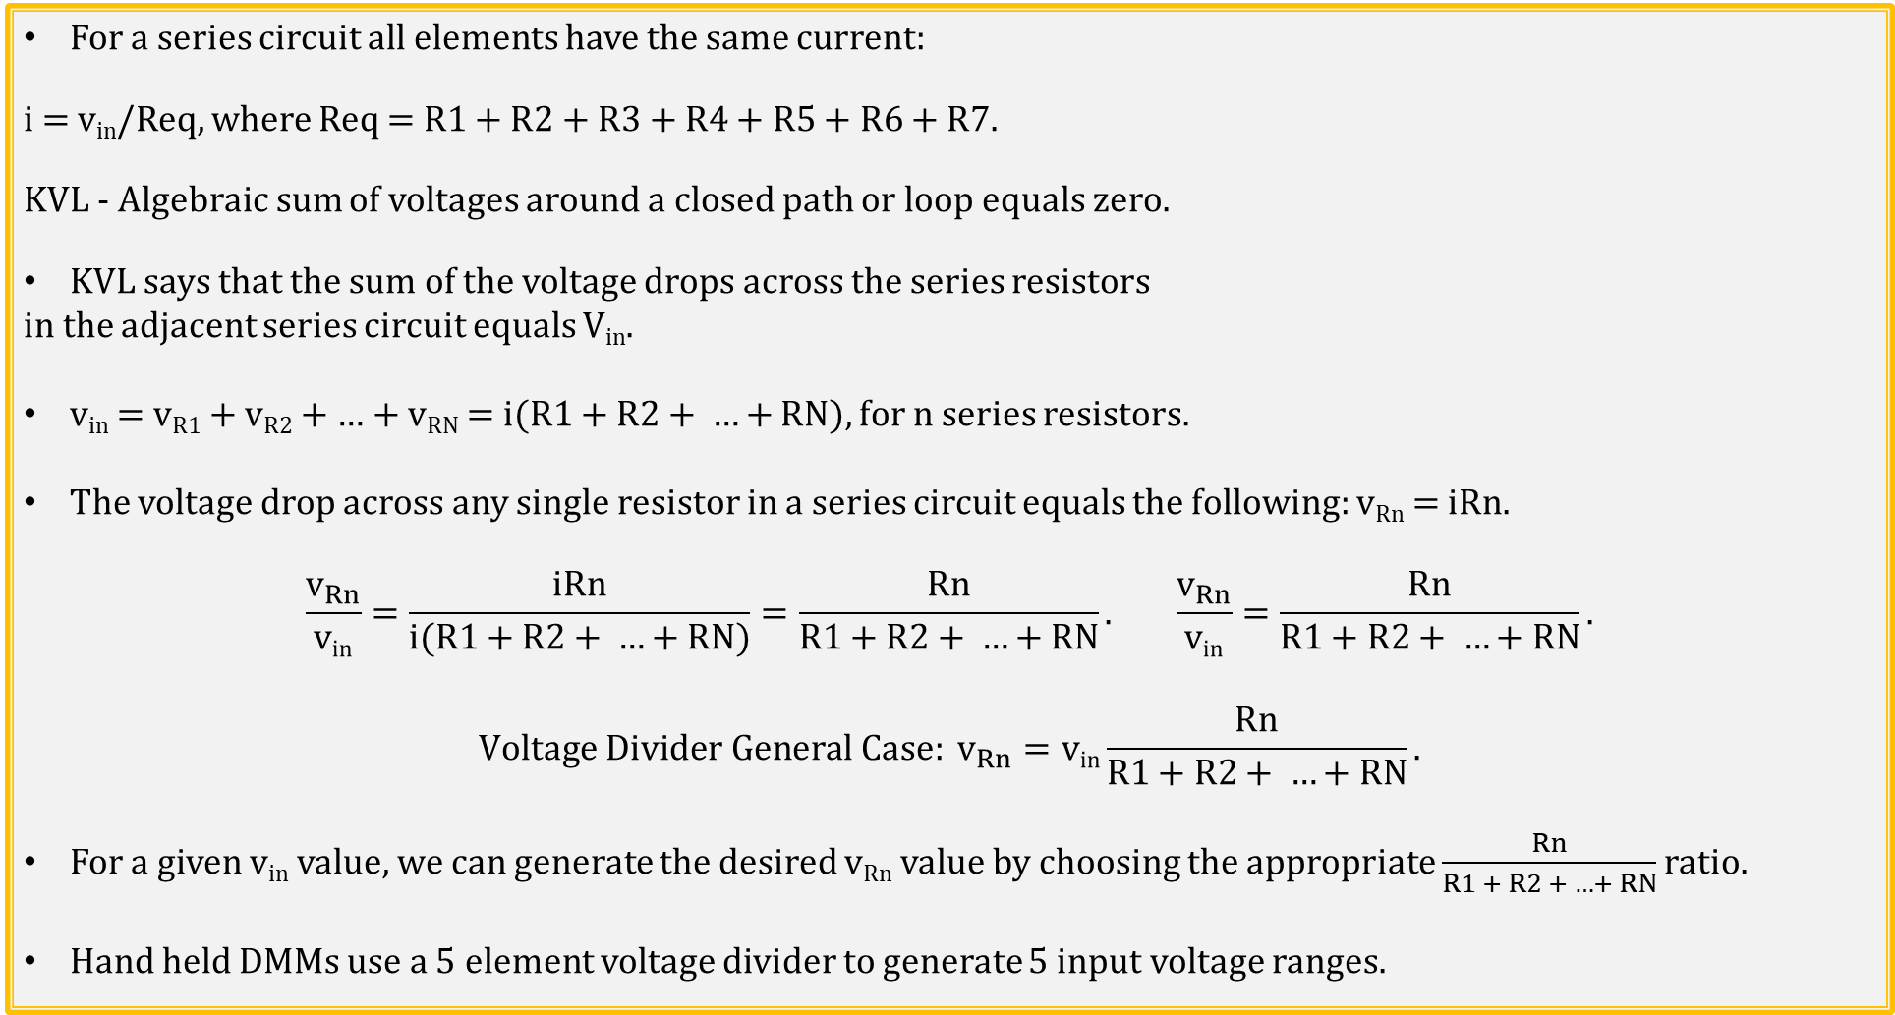
Voltage Divider → General Case
For a series circuit all elements have the same current:
i = v_{in}/Req, where Req = R1 + R2 + R3 + R4 + R5 + R6 + R7.
KVL - Algebraic sum of voltages around a closed path or loop equals zero.
KVL says that the sum of the voltage drops across the series resistors
in the adjacent series circuit equals V_{in}.
v_{in} = v_{R1} + v_{R2} + … + v_{RN} = i($R1+R2+ …+$ RN), for n series resistors.
The voltage drop across any single resistor in a series circuit equals the following: v_{Rn} = iRn.
$$\frac{v_{Rn}}{\text{v}\text{in}}=\frac{iRn}{i(R1+R2+ …+RN)}=\frac{Rn}{R1+R2+ …+RN}. \frac{v_{Rn}}{\text{v}\text{in}}=\frac{Rn}{R1+R2+ …+RN}.$$
$$Voltage Divider General Case: v_{Rn}=\text{v}\text{in}\frac{Rn}{R1+R2+ …+RN}.$$
For a given v_{in} value, we can generate the desired v_{Rn} value by choosing the appropriate $\frac{Rn}{R1 + R2 + …+ RN}$ ratio.
Hand held DMMs use a 5 element voltage divider to generate 5 input voltage ranges.
Notes:
Image by instructor

Slide 32
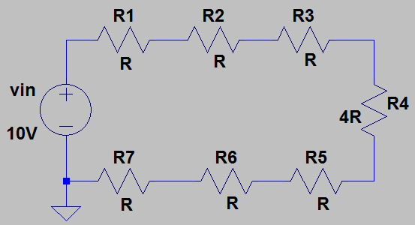
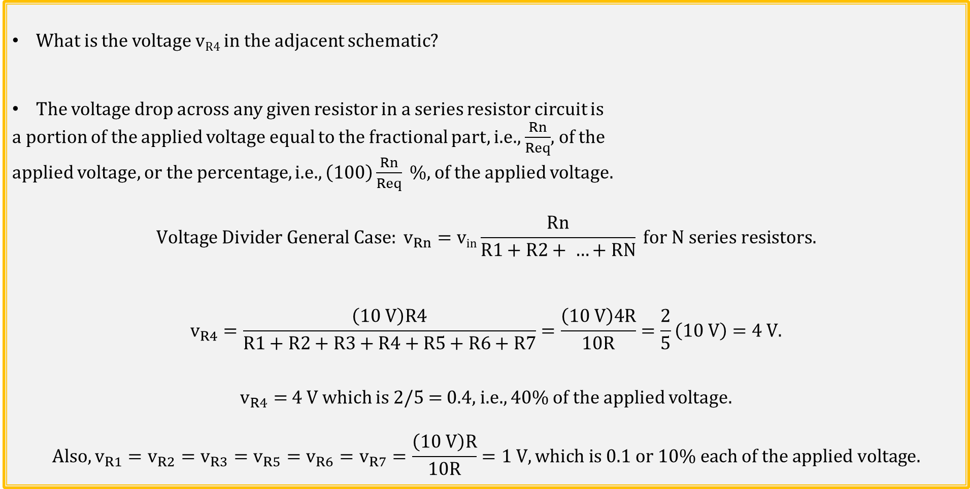
Voltage Divider Example 1
What is the voltage v_{R4} in the adjacent schematic?
The voltage drop across any given resistor in a series resistor circuit is
a portion of the applied voltage equal to the fractional part, i.e., $\frac{Rn}{Req}$, of the
applied voltage, or the percentage, i.e., $\left(100\right)\frac{Rn}{Req} \%,$ of the applied voltage.
$$Voltage Divider General Case: v_{Rn}=\text{v}\text{in}\frac{Rn}{R1+R2+ …+RN} for N series resistors.$$
$$v_{R4}=\frac{\left(10 V\right)R4}{R1+R2+R3+R4+R5+R6+R7}=\frac{\left(10 V\right)4R}{10R}=\frac{2}{5}\left(10 V\right)=4 V.$$
$v_{R4}=$4 V which is 2/5 = 0.4, i.e., 40% of the applied voltage.
$$Also, v_{R1}=v_{R2}=v_{R3}=v_{R5}=v_{R6}=v_{R7}=\frac{\left(10 V\right)R}{10R}=1 V, which is 0.1 or 10\% each of the applied voltage.$$
Notes:
Image by instructor

Slide 33
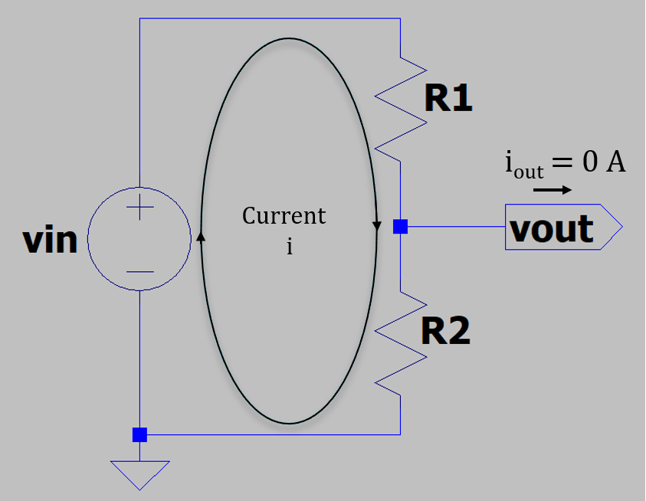
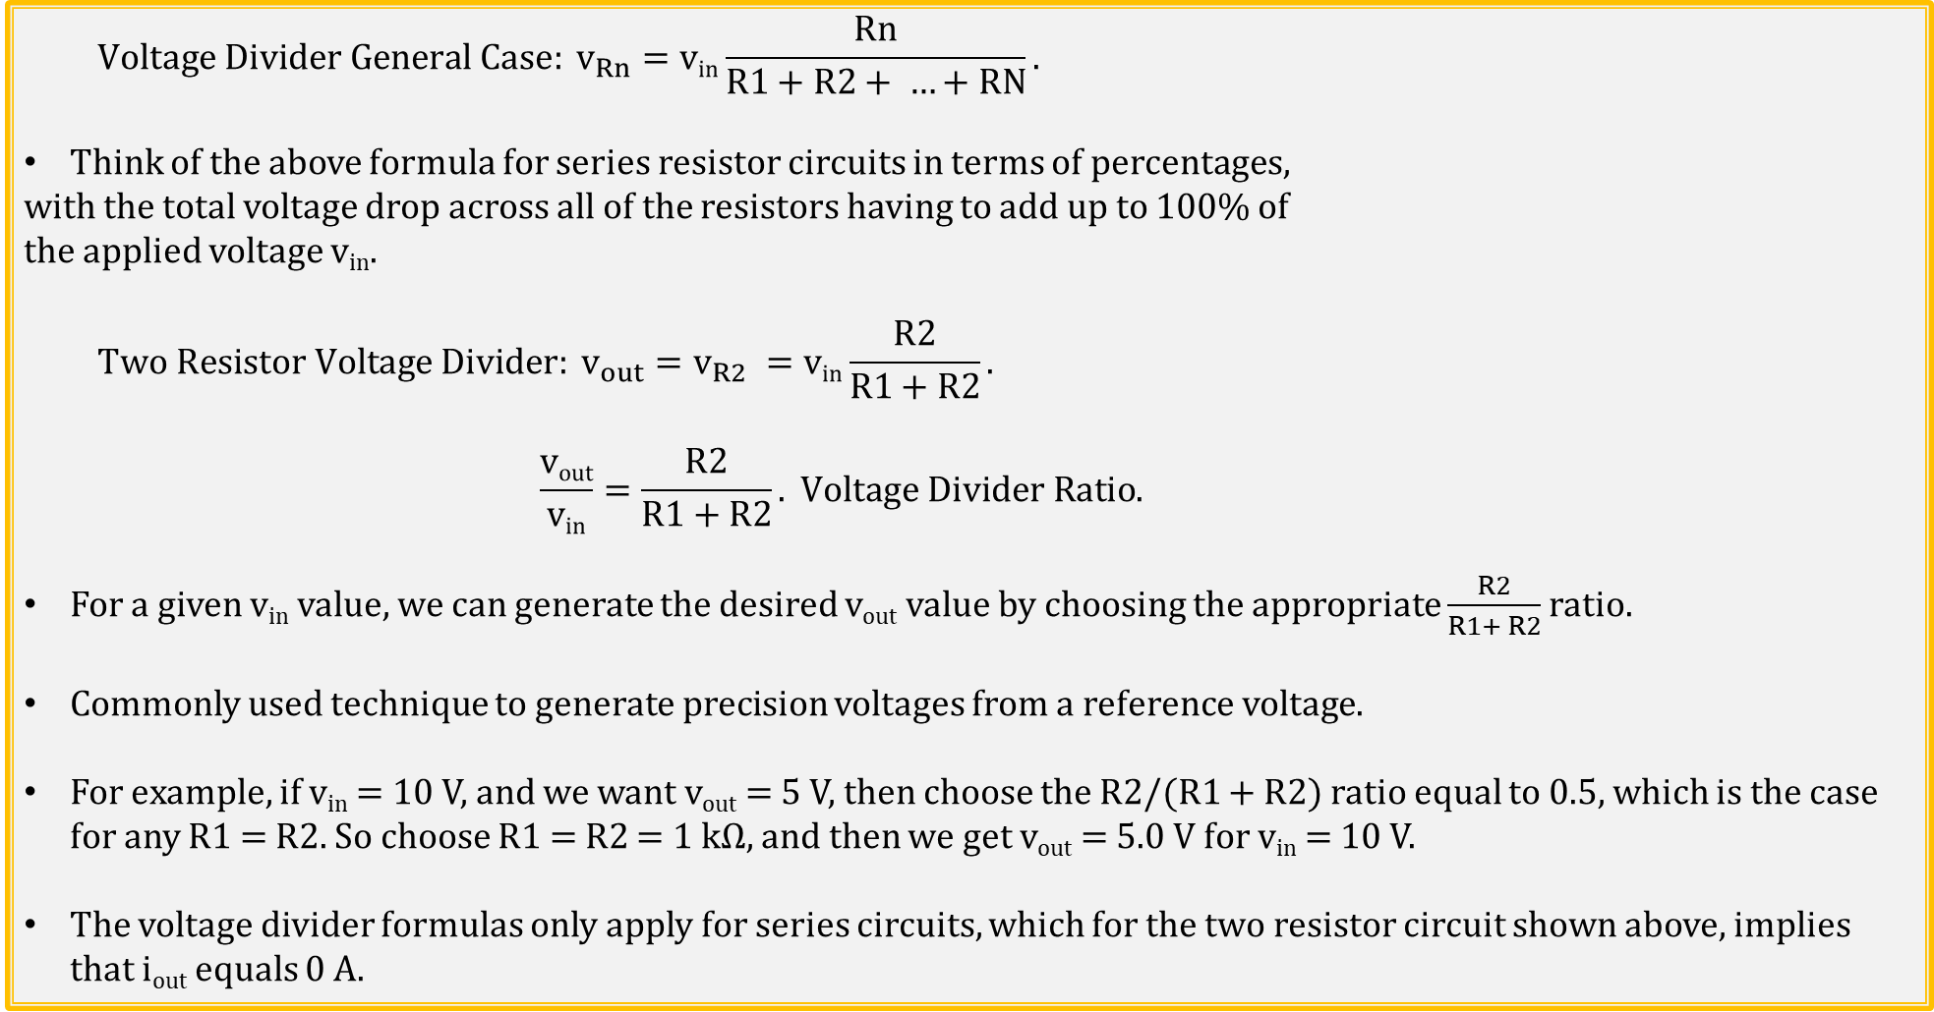
Voltage Divider → Two Resistors
$$Voltage Divider General Case: v_{Rn}=\text{v}\text{in}\frac{Rn}{R1+R2+ …+RN}.$$
Think of the above formula for series resistor circuits in terms of percentages,
with the total voltage drop across all of the resistors having to add up to 100% of
the applied voltage v_{in}.
$$Two Resistor Voltage Divider: v_{out}=v_{R2} =\text{v}\text{in}\frac{R2}{R1+R2}.$$
$$\frac{\text{v}\text{out}}{\text{v}\text{in}}=\frac{R2}{R1+R2}. Voltage Divider Ratio.$$
For a given v_{in} value, we can generate the desired v_{out} value by choosing the appropriate $\frac{R2}{R1+ R2}$ ratio.
Commonly used technique to generate precision voltages from a reference voltage.
For example, if v_{in} = 10 V, and we want v_{out} = 5 V, then choose the R2/(R1 + R2) ratio equal to 0.5, which is the case for any R1 = R2. So choose R1 = R2 = 1 kΩ, and then we get v_{out} = 5.0 V for v_{in} = 10 V.
The voltage divider formulas only apply for series circuits, which for the two resistor circuit shown above, implies that i_{out} equals 0 A.
Notes:
Image by instructor

Slide 34
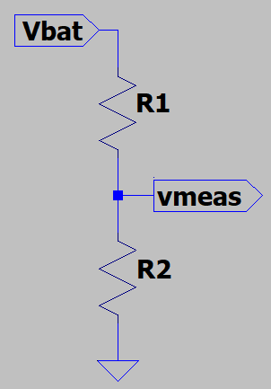
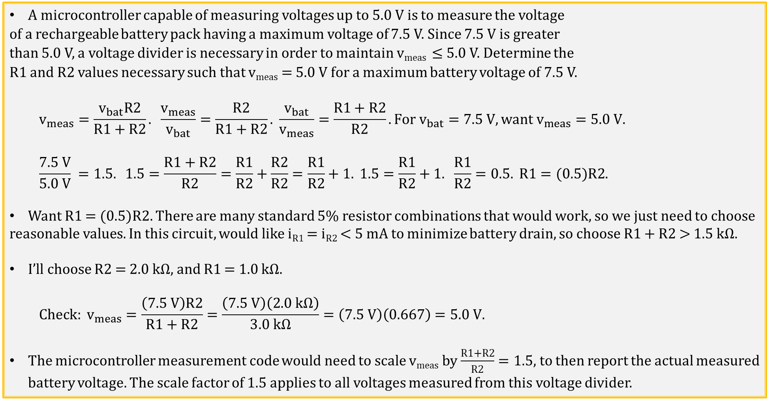
Two Resistor Voltage Divider Application
A microcontroller capable of measuring voltages up to 5.0 V is to measure the voltage
of a rechargeable battery pack having a maximum voltage of 7.5 V. Since 7.5 V is greater
than 5.0 V, a voltage divider is necessary in order to maintain v_{meas} ≤ 5.0 V. Determine the
R1 and R2 values necessary such that v_{meas} = 5.0 V for a maximum battery voltage of 7.5 V.
$$v_{meas}=\frac{v_{bat}R2}{R1+R2}. \frac{v_{meas}}{v_{bat}}=\frac{R2}{R1+R2}. \frac{v_{bat}}{v_{meas}}=\frac{R1+R2}{R2}. For v_{bat}=7.5 V, want v_{meas}=5.0 V.$$
$$\frac{7.5 V}{5.0 V} =1.5. 1.5=\frac{R1+R2}{R2}=\frac{R1}{R2}+\frac{R2}{R2}=\frac{R1}{R2}+1. 1.5=\frac{R1}{R2}+1. \frac{R1}{R2}=0.5. R1=(0.5)R2.$$
Want R1 = (0.5)R2. There are many standard 5% resistor combinations that would work, so we just need to choose
reasonable values. In this circuit, would like i_{R1} = i_{R2} < 5 mA to minimize battery drain, so choose R1 + R2 > 1.5 kΩ.
I’ll choose R2 = 2.0 kΩ, and R1 = 1.0 kΩ.
$$Check: v_{meas}=\frac{\left(7.5 V\right)R2}{R1+R2}=\frac{\left(7.5 V\right)\left(2.0 kΩ\right)}{3.0 kΩ}=\left(7.5 V\right)\left(0.667\right)=5.0 V.$$
The microcontroller measurement code would need to scale v_{meas} by $\frac{R1+R2}{R2}=1.5,$ to then report the actual measured battery voltage. The scale factor of 1.5 applies to all voltages measured from this voltage divider.
Poll Questions

Slide 35
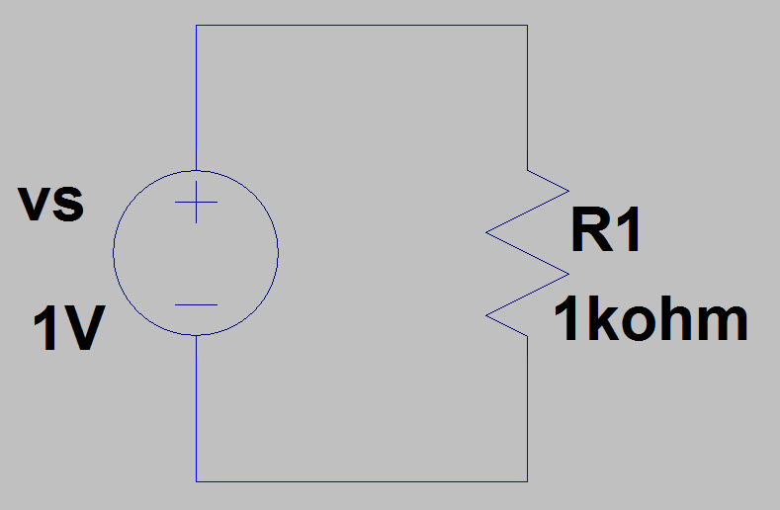
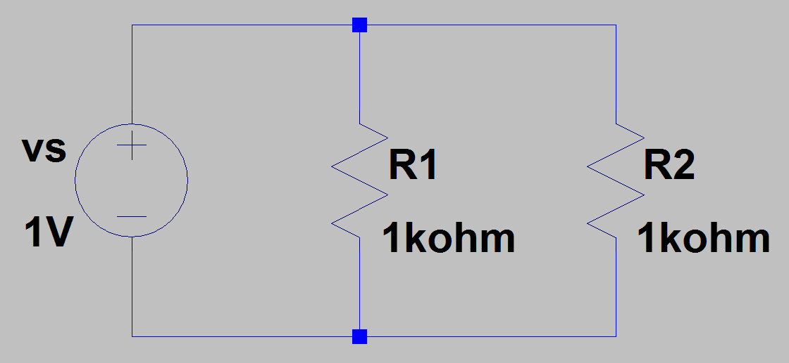
Parallel Resistors Example
For series circuit below what is i_{R1}?
i_{R1} = i_{s} = v_{s}/R1 = (1 V)/(1 kΩ) = 1 mA.
For parallel circuit below what is i_{R1}, i_{R2}, and i_{S}?
i_{R1} = v_{s}/R1 = (1 V)/(1 kΩ) = 1 mA.
i_{R2} = v_{s}/R2 = (1 V)/(1 kΩ) = 1 mA.
i_{S} = i_{R1} + i_{R2} = 2 mA.
Req = v_{s}/i_{S} = (1 V)/(2 mA) = 500 Ω. Req = R1||R2 = 500 Ω.
For parallel circuits, Req is smaller than the smallest of the individual resistors.
Notes:
Image by instructor

Slide 36
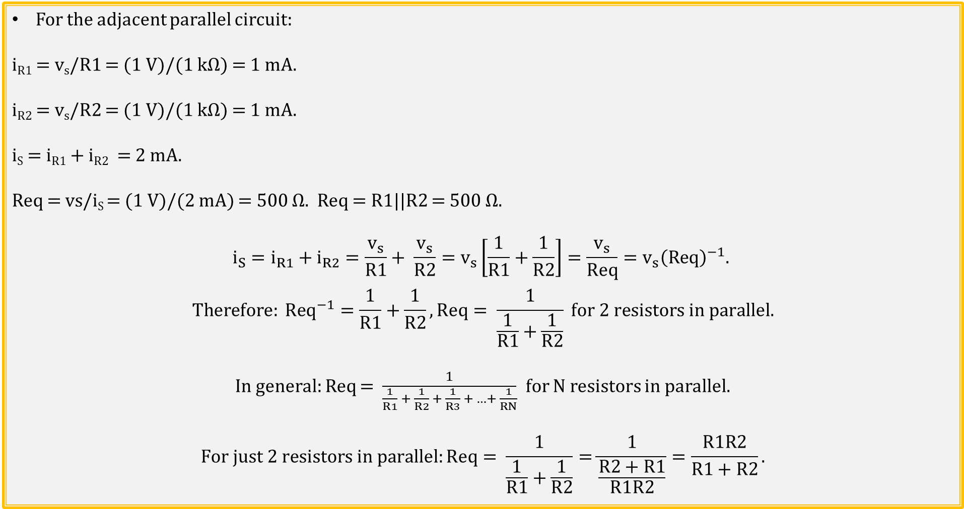
Equivalent Parallel Resistance
For the adjacent parallel circuit:
i_{R1} = v_{s}/R1 = (1 V)/(1 kΩ) = 1 mA.
i_{R2} = v_{s}/R2 = (1 V)/(1 kΩ) = 1 mA.
i_{S} = i_{R1} + i_{R2} = 2 mA.
Req = vs/i_{S} = (1 V)/(2 mA) = 500 Ω. Req = R1||R2 = 500 Ω.
$$i_{S}=i_{R1}+i_{R2}=\frac{v_{s}}{R1}+ \frac{v_{s}}{R2}=v_{s}\left[\frac{1}{R1}+\frac{1}{R2}\right]=\frac{v_{s}}{Req}={v_{s}\left(Req\right)}^{−1}.$$
$$Therefore: {Req}^{−1}=\frac{1}{R1}+\frac{1}{R2}, Req= \frac{1}{\frac{1}{R1}+\frac{1}{R2}} for 2 resistors in parallel.$$
In general: Req = $\frac{1}{\frac{1}{R1} + \frac{1}{R2} + \frac{1}{R3} + …+ \frac{1}{RN}}$ for N resistors in parallel.
$$For just 2 resistors in parallel:Req= \frac{1}{\frac{1}{R1}+\frac{1}{R2}}=\frac{1}{\frac{R2+R1}{R1R2}}=\frac{R1R2}{R1+R2}.$$
Notes:
Image by instructor

Slide 37
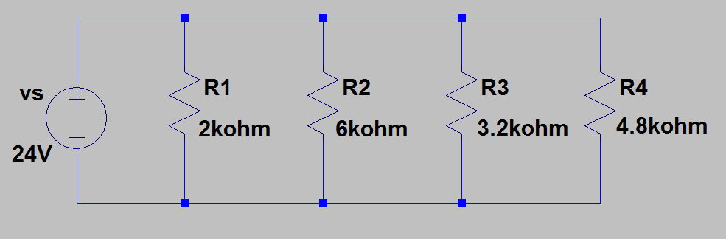
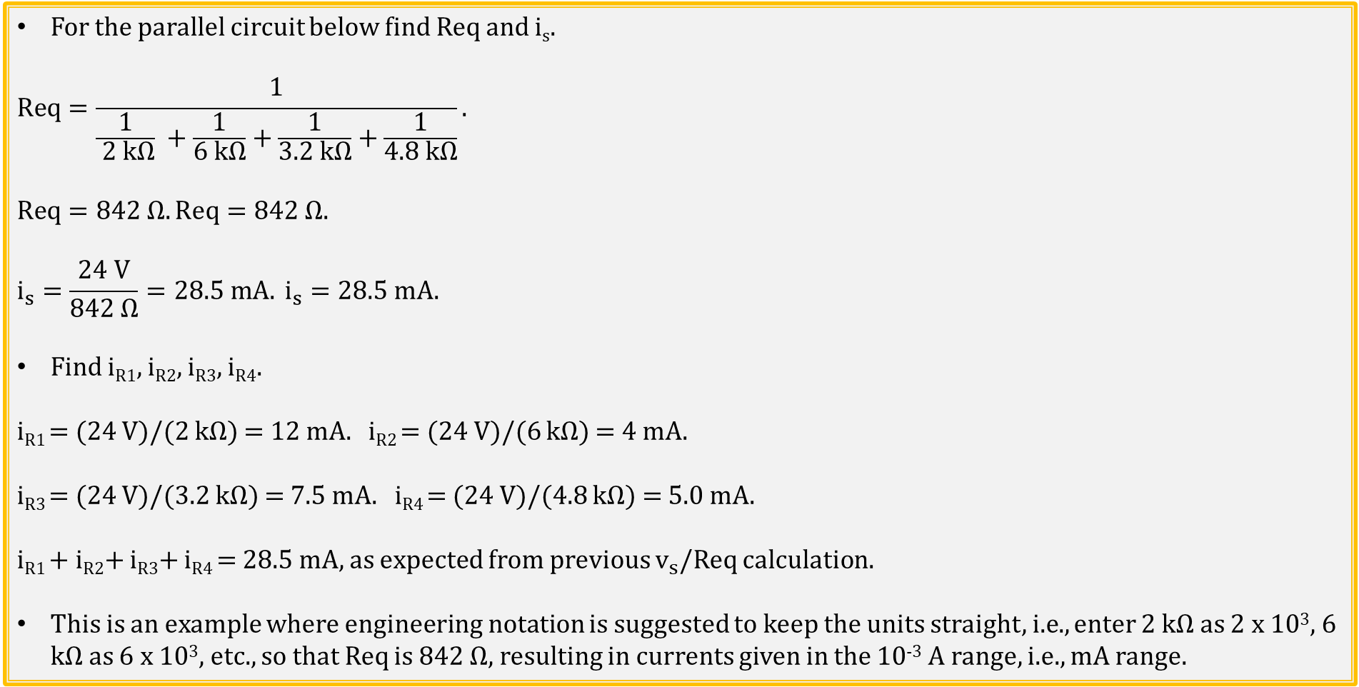
Equivalent Parallel Resistance Example 1
For the parallel circuit below find Req and i_{s}.
$$Req=\frac{1}{\frac{1}{ 2 kΩ} +\frac{1}{6 kΩ}+\frac{1}{3.2 kΩ}+\frac{1}{4.8 kΩ}}.$$
$$Req=842 Ω. Req=842 Ω.$$
$$i_{s}=\frac{24 V}{842 Ω}=28.5 mA. i_{s}=28.5 mA.$$
Find i_{R1}, i_{R2}, i_{R3}, i_{R4}.
i_{R1} = (24 V)/(2 kΩ) = 12 mA. i_{R2} = (24 V)/(6 kΩ) = 4 mA.
i_{R3} = (24 V)/(3.2 kΩ) = 7.5 mA. i_{R4} = (24 V)/(4.8 kΩ) = 5.0 mA.
i_{R1} + i_{R2}+ i_{R3}+ i_{R4} = 28.5 mA, as expected from previous $v_{s}$/Req calculation.
This is an example where engineering notation is suggested to keep the units straight, i.e., enter 2 kΩ as 2 x 10³, 6 kΩ as 6 x 10³, etc., so that Req is 842 Ω, resulting in currents given in the 10⁻³ A range, i.e., mA range.
Notes:
Image by instructor

Slide 38
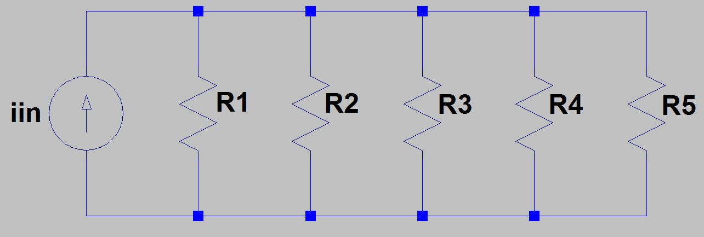
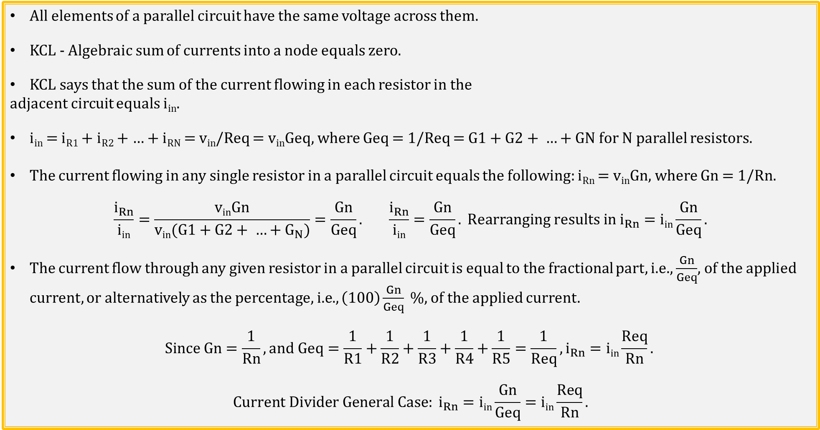
Current Divider → General Case
All elements of a parallel circuit have the same voltage across them.
KCL - Algebraic sum of currents into a node equals zero.
KCL says that the sum of the current flowing in each resistor in the
adjacent circuit equals i_{in}.
i_{in} = i_{R1} + i_{R2} + … + i_{RN} = v_{in}/Req = v_{in}Geq, where Geq = 1/Req = $G1+G2+ …+GN$ for N parallel resistors.
The current flowing in any single resistor in a parallel circuit equals the following: i_{Rn} = v_{in}Gn, where Gn = 1/Rn.
$$\frac{i_{Rn}}{\text{i}\text{in}}=\frac{\text{v}\text{in}\text{Gn}}{\text{v}\text{in}\text{(}G1+G2+ …+G_{N}\text{)}}=\frac{Gn}{Geq}. \frac{i_{Rn}}{\text{i}\text{in}}=\frac{Gn}{Geq}. Rearranging results in i_{Rn}=\text{i}\text{in}\frac{Gn}{Geq}.$$
The current flow through any given resistor in a parallel circuit is equal to the fractional part, i.e., $\frac{Gn}{Geq}$, of the applied current, or alternatively as the percentage, i.e., $\left(100\right)\frac{Gn}{Geq} \%,$ of the applied current.
$$Since Gn=\frac{1}{Rn}, and Geq=\frac{1}{R1}+\frac{1}{R2}+\frac{1}{R3}+\frac{1}{R4}+\frac{1}{R5}=\frac{1}{Req}, i_{Rn}=\text{i}\text{in}\frac{Req}{Rn}.$$
$$Current Divider General Case: i_{Rn}=\text{i}\text{in}\frac{Gn}{Geq}=\text{i}\text{in}\frac{Req}{Rn}.$$
Notes:
Image by instructor

Slide 39
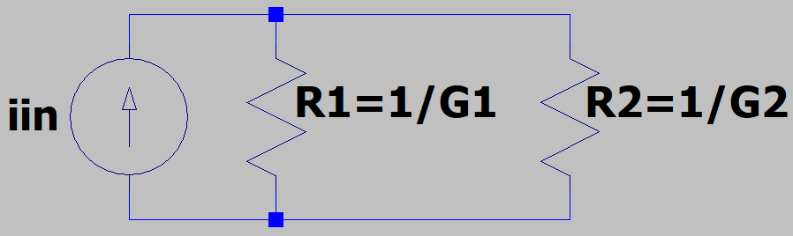
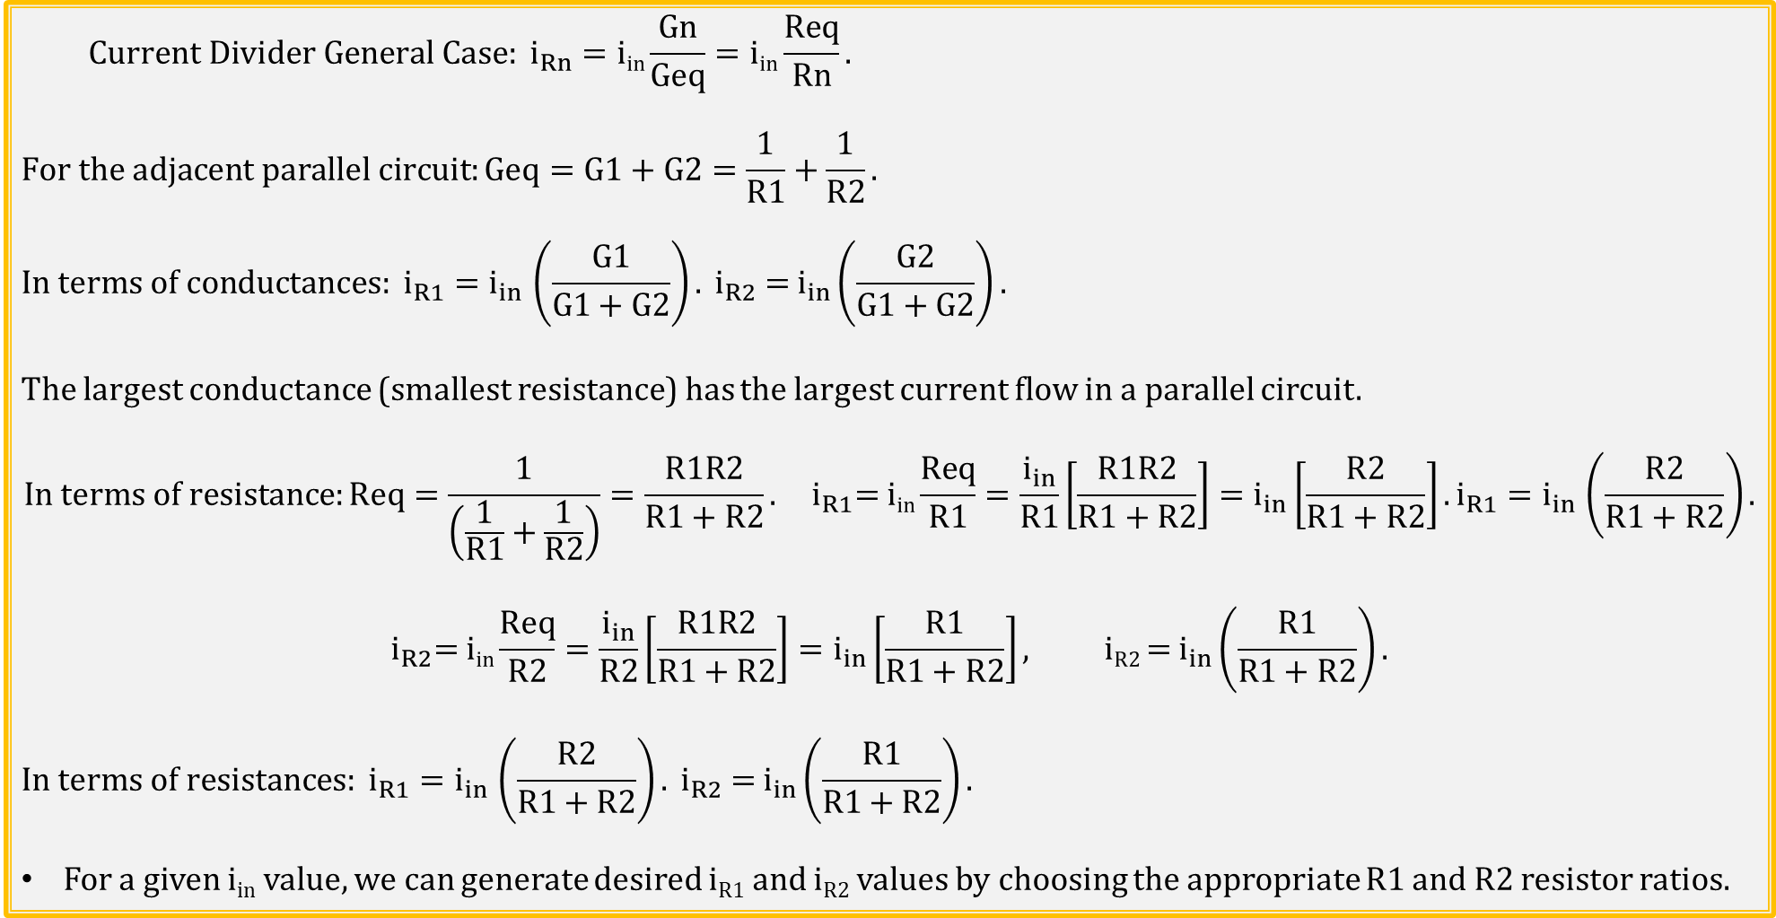
Current Divider - Two Resistors
$$Current Divider General Case: i_{Rn}=\text{i}\text{in}\frac{Gn}{Geq}=\text{i}\text{in}\frac{Req}{Rn}.$$
$$For the adjacent parallel circuit:Geq=G1+G2=\frac{1}{R1}+\frac{1}{R2}.$$
$$In terms of conductances: i_{R1}{=i}_{in}\left(\frac{G1}{G1+G2}\right). i_{R2} \text{= }i_{in}\left(\frac{G2}{G1+G2}\right).$$
The largest conductance (smallest resistance) has the largest current flow in a parallel circuit.
$$In terms of resistance:Req=\frac{1}{\left(\frac{1}{R1}+\frac{1}{R2}\right)}=\frac{R1R2}{R1+R2}. i_{R1}\text{= }\text{i}\text{in}\frac{Req}{R1}=\frac{i_{in}}{R1}\left[\frac{R1R2}{R1+R2}\right]=i_{in}\left[\frac{R2}{R1+R2}\right].i_{R1}{=i}_{in}\left(\frac{R2}{R1+R2}\right).$$
$$i_{R2}\text{= }\text{i}\text{in}\frac{Req}{R2}=\frac{i_{in}}{R2}\left[\frac{R1R2}{R1+R2}\right]=i_{in}\left[\frac{R1}{R1+R2}\right], \text{iR}\text{2 }\text{= }i_{in}\left(\frac{R1}{R1+R2}\right).$$
$$In terms of resistances: i_{R1}{=i}_{in}\left(\frac{R2}{R1+R2}\right). i_{R2} \text{= }i_{in}\left(\frac{R1}{R1+R2}\right).$$
For a given i_{in} value, we can generate desired i_{R1} and i_{R2} values by choosing the appropriate R1 and R2 resistor ratios.
Notes:
Image by instructor

Slide 40
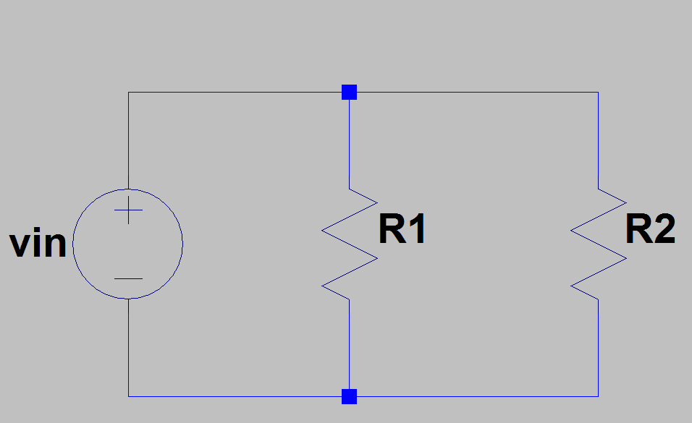
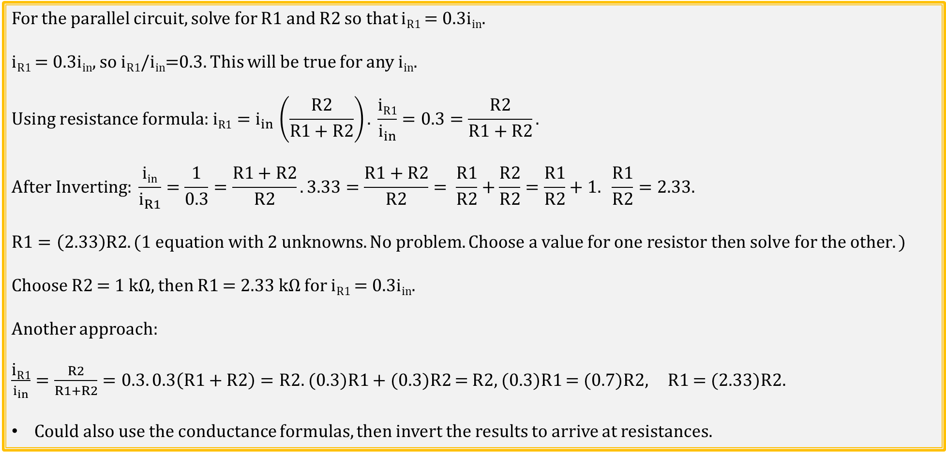
Current Divider Example
For the parallel circuit, solve for R1 and R2 so that i_{R1} = 0.3i_{in}.
i_{R1} = 0.3i_{in}, so i_{R1}/i_{in}=0.3. This will be true for any i_{in}.
$$\text{Using} \text{resistance} \text{formula}\text{: }\text{i}\text{R}\text{1}{=i}_{in}\left(\frac{R2}{R1+R2}\right). \frac{\text{i}\text{R}\text{1}}{i_{in}}=0.3=\frac{R2}{R1+R2}.$$
$$After Inverting: \frac{\text{i}\text{in}}{i_{R1}}=\frac{1}{0.3}=\frac{R1+R2}{R2}.3.33=\frac{R1+R2}{R2}= \frac{R1}{R2}+\frac{R2}{R2}=\frac{R1}{R2}+1. \frac{R1}{R2}=2.33.$$
$$R1=\left(2.33\right)R2. (1 equation with 2 unknowns. No problem. Choose a value for one resistor then solve for the other.)$$
Choose R2 = 1 kΩ, then R1 = 2.33 kΩ for i_{R1} = 0.3i_{in}.
Another approach:
$\frac{\text{i}\text{R}\text{1}}{i_{in}}=\frac{R2}{R1+R2}=0.3. 0.3\left(R1+R2\right)=R2.$(0.3)R1 + (0.3)R2 = R2, (0.3)R1 = (0.7)R2, R1 = (2.33)R2.
Could also use the conductance formulas, then invert the results to arrive at resistances.
i_{in}
Notes:
Image by instructor

Slide 41
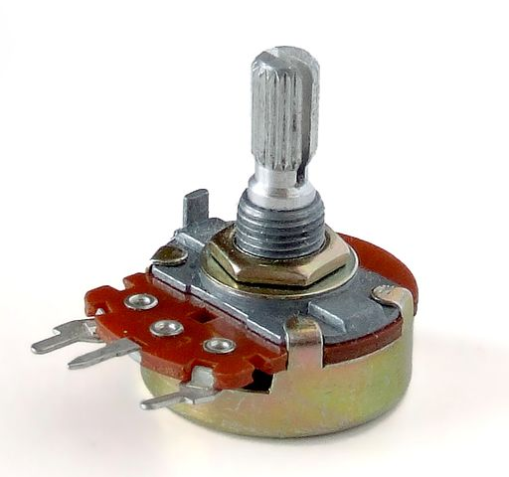

Potentiometer – Adjustable Voltage Divider
Circuit Symbol
Wiper Terminal
This device is referred to as a Trim Pot,
i.e. , Trim Potentiometer.
Notes:
https://commons.wikimedia.org/wiki/File%3ASingle-turn_potentiometer_with_internals_exposed%2C_oblique_view.jpg
https://commons.wikimedia.org/wiki/File%3APotentiometer.jpg

Slide 42





Potentiometer – Adjustable Voltage Divider
R_{top}
R_{pot}
v_{wiper} = $\frac{\left(5 V\right)R_{bot}}{R_{top}+{ R}_{bot}}$. $R_{top}+{ R}_{bot}$ = R_{pot} . v_{wiper} = $\frac{\left(5 V\right)R_{bot}}{R_{pot}}$. If R_{bot} = R_{top}, then v_{wiper} = 2.5 V.
R_{bot}
$R_{top}$= $0 Ω$. v_{wiper_max} = $\frac{\left(5 V\right)R_{bot_max}}{R_{pot}}$ = $\frac{\left(5 V\right)R_{pot}}{R_{pot}}$ = 5 V.
R_{pot}
R_{pot}
$R_{bot}$= $0 Ω$. v_{wiper_min} = $\frac{\left(5 V\right)R_{bot_min}}{R_{pot}}$ = $\frac{\left(5 V\right)(0 Ω)}{R_{pot}}$ = 0 V.

Slide 43


Potentiometer Example
For the adjacent schematic, R_{pot} represents a potentiometer with total resistance
of 500 Ω. The potentiometer wiper can be adjusted so that at one adjustment limit all
500 Ω of resistance are below the wiper, and at the other adjustment limit all 500 Ω
of resistance are above the wiper. Solve for the wiper voltage v_{wiper} at the two
adjustment limits, i.e. v_{wiper_max} and v_{wiper_min} using the voltage divider relationship.
$$R_{top}+R_{bot}=R1+R_{pot}+R2=2.5 kΩ.$$
$$v_{wiper}=\frac{\left(v_{s}\right)R_{bot}}{R_{top}+R_{bot}}=\frac{\left(10 V\right)R_{bot}}{2.5 kΩ}. v_{wiper}=\frac{\left(10 V\right)R_{bot}}{2.5 kΩ}.$$
$$v_{wiper_max}=\frac{\left(10 V\right)R_{bot_max}}{2.5 kΩ}=\frac{\left(10 V\right)\left(1.5 kΩ\right)}{2.5 kΩ}=6.00 V. v_{wiper_max}=6.00 V.$$
$$v_{wiper_min}=\frac{\left(10 V\right)R_{bot_min}}{2.5 kΩ}=\frac{\left(10 V\right)\left(1.0 kΩ\right)}{2.5 kΩ}=4.00 V. v_{wiper_min}=4.00 V.$$
For the wiper set so that there is 250 Ω above the wiper and 250 Ω, i.e. in exact middle of the trim pot, the wiper the output voltage would be as follows:
$$v_{wiper}=\frac{\left(10 V\right)R_{bot}}{2.5 kΩ}=\frac{\left(10 V\right)\left(1.25 kΩ\right)}{2.5 kΩ}=5.00 V. v_{wiper}=5.00 V.$$

Slide 44

Series versus Parallel Resistor Circuits
Current is the same through all elements of a series circuit.
Req_series = R1 + R2 + …. + RN. For multiple resistors, Req is always larger than the largest resistor value.
From KVL, the voltage drop across any given resistor in a series circuit is equal to the fractional part, i.e., $\frac{Rn}{Req}$, of the applied voltage, or alternatively as the percentage, i.e., $\left(100\right)\frac{Rn}{Req} \%,$ of the applied voltage. (Voltage Divider.)
Voltage is the same across all elements of a parallel circuit.
Req_parallel = $\frac{1}{\frac{1}{R1}+\frac{1}{R2}+\frac{1}{R3}+ …+\frac{1}{RN}}. For multiple resistors,Req is always smaller than the smallest resistor value.$
$The above \text{Req}\text{_}\text{parallel} formula is equivalent to \frac{R1R2}{R1+R2} for 2 parallel resistors.$
Conductance G = 1/R can simplify calculations involving parallel circuits.
$For 2 parallel resistors: Geq=G1+G2=\frac{1}{R1}+\frac{1}{R2}=\frac{R2+R1}{R1R2}=\frac{1}{Req}.$
From KCL, the current flow through any given resistor in a parallel circuit is equal to the fractional part, i.e., $\frac{Gn}{Geq}$, of the applied current, or alternatively as the percentage, i.e., $\left(100\right)\frac{Gn}{Geq} \%,$ of the applied current. (Current Divider.)
Notes:
Image by instructor

Slide 45


Series-Parallel Circuit Example 1
For the adjacent series-parallel circuit,
solve for Req.
R4 + R5 = 2R.
$$\text{R}\text{3ǁ(}\text{R}\text{4 + }\text{R}\text{5) = 2}\text{R}\text{ǁ2}\text{R}=\frac{1}{1/{2R}+1/{2R}}=\frac{1}{2/{2R}}=\frac{1}{1/R}=R.$$
R2 + [R3ǁ(R4 + R5)] = R + R = 2R.
Req = R1ǁ{R2 + [R3ǁ(R4 + R5)]} = 2Rǁ2R = R.
Req = R.
Notes:
Image by instructor

Slide 46


Series-Parallel Circuit Example 2
For the adjacent series-parallel circuit, solve for Req and i_{R5}.
Req = R1 + R2ǁR3 + R4ǁR5.
$$\text{R}\text{2}\text{ǁ}\text{R}\text{3}=\frac{1}{\frac{1}{\text{2.7 }\text{k}\text{Ω}}+\frac{1}{\text{2.2 }\text{k}\text{Ω}}}=\text{1.21 }\text{k}\text{Ω.}$$
Or R2ǁR3 = (2.7 kΩ)( 2.2 kΩ)/(2.7 kΩ + 2.2 kΩ) = 1.21 kΩ.
$$\text{R}\text{4}\text{ǁ}\text{R}5=\frac{1}{\frac{1}{\text{3.3} \text{k}\text{Ω}}+\frac{1}{\text{1.8} \text{k}\text{Ω}}}=\text{1.1}\text{6} \text{k}\text{Ω.}$$
Or R4ǁR5 = (3.3 kΩ)( 1.8 kΩ)/(3.3 kΩ + 1.8 kΩ) = 1.16 kΩ .
Req = 1 kΩ + 1.21 kΩ + 1.16 kΩ = 3.37 kΩ. Req = 3.37 kΩ.
i_{S} = (10 V)/(3.37 kΩ) = 2.97 mA.
v3 = i_{S}R4ǁR5 = (2.97 mA)(1.16 kΩ) = 3.43 V.
i_{R5} = v3/R5 = (3.43 V)/(1.8 kΩ) = 1.91 mA. i_{R5} = 1.91 mA.
Notes:
Image by instructor

Slide 47


Series-Parallel Circuit Example 3
For the series-parallel circuit below, solve for Req, v_{R2} and v_{R4}.
Req = R1 + [R2ǁ(R3 + R4)].
$$\text{R}\text{2ǁ(}\text{R}\text{3+ }\text{R}\text{4)}=\frac{1}{\frac{1}{\text{2.7 }\text{k}\text{Ω}}+\frac{1}{\text{5.5} \text{k}\text{Ω}}}=\text{1.}\text{8}\text{1 }\text{k}\text{Ω.}$$
Or R2ǁ(R3 + R4) = (2.7 kΩ)( 5.5 kΩ)/(2.7 kΩ + 5.5 kΩ) = 1.81 kΩ
Req = 1 kΩ + 1.81 kΩ = 2.81 kΩ. Req = 2.81 kΩ.
i_{S} = (10 V)/(2.81 kΩ) = 3.56 mA.
v_{R2} = 10 V – v_{R1} = (10 V - i_{S}R1) = 10 V – 3.56 V = 6.44 V.
v_{R2} = 6.44 V.
i_{R4} = v_{R2}/(R3 + R4) = (6.44 V)/(5.5 kΩ) = 1.17 mA.
v_{R4} = i_{R4}R4 = (1.17 mA)(3.3 kΩ) = 3.86 V.
v_{R4} = 3.86 V.
Poll Questions
Notes:
Image by instructor

Slide 48

Series Circuit Application – Christmas Tree Lights
Common Christmas Tree lights use series
strings of 50 bulbs, so that each bulb has less
than 5 V across it.
Obvious problem with series string is that a
broken filament in one bulb takes out the entire
string and is hard to find.
Engineering to the rescue.
Standard mini-light bulb with insulated shunt
wire in case the filament breaks.
Broken filament results in entire string voltage
across one bulb, which heats the insulated shunt
wire, melting off the insulation and then shorting
across the two leads.
Result is broken filament does not take out entire
series string and bad bulb can easily be found.
Filament
Shunt Wire
Notes:
Image by instructor

Slide 49

Parallel Circuit Application – Terminal Strip
On/off switch and surge protection often included in terminal strips.
Several parallel high-current loads can exceed home circuit breakers.
Notes:
Image by instructor

Slide 50

Metric Prefixes – Engineering Notation
Except for deca and deci, all prefixes involve multiples 10 x 10³ or 10 x 10⁻³.
Engineering notation, a special case of scientific notation where exponents are displayed as multiples of 10³ or 10⁻³.
Set calculators for Engineering mode, which then adjusts results to be displayed in scientific notation with base 10 exponents in multiples of 3.
For example, in Engineering mode, a calculated result of 10 x 10² in units of Ω is displayed as 1 x 10³, then written as 1 kΩ.
Then if entering 1 kΩ, into a calculator, enter
1 x 10³ instead of just 1.

Slide 51

Scientific Notation – Useful for very large or small.
Speed of Light: $3.0 x {10}^{8} \frac{m}{S}.$ Boltzmann Constant: $1.38 x {10}^{−23} \frac{J}{K}.$Charge of an Electron: $1. 6 x {10}^{−19} C.$
Engineering/Scientific notation highly recommended when dealing with such large and small quantities.
Engineering notation and Engineering mode for calculators recommended for problems solved in this class, along with other ECEN classes
For example, (10 kΩ)(1 µA) would best be entered in a calculator as (10 x 10³ Ω)(1 x 10⁻⁶A) = 10 x 10⁻³ = 10 mV.
This is much less error prone than entering say 10 for 10 kΩ and 1 for 1 µA, which then multiplied together equals 10. Yet what prefix is to be assigned to the 10, since it involved kΩ multiplied by µA, instead of Ω multiplied by A? Formally you adjust the decimal point by moving it three to the right for the kΩ, followed by 6 to the left for the µA, which is an overall adjustment of 3 to left, resulting in 0.01 V = 10 mV. Yet this approach is error prone, and can be completely avoided by entering all numbers without metric prefixes, then let the calculator figure out decimal places, and return the result using engineering notation so that it is easy to write the answer in terms of metric prefixes.
When doing MATLAB or calculator calculations with 1 µA, it is recommended to enter the value using engineering/scientific notation, i.e. enter this current in units of Amps (A), such as 1E-6 in MATLAB.
Engineering notation in MATLAB: Home → Preferences → Command Window → Numeric Format → short eng.

Slide 52
Electrical Power Supplies
Power supplies provide electrical energy.
2 Major Types of Electrical Power Supplies:
Voltage Sources.
Current Sources.
Ideal voltage source provides constant voltage at the terminals for any load current.
Electrochemical batteries are good examples of a voltage source.
Ideal current source provides constant current at the terminals for any load voltage.
Solar panels are good examples of a current source.
How Do Batteries Work (4:19)
Notes:
Image by instructor

Slide 53
Series and Parallel Voltage Sources
Series Voltage Sources → Good idea.
Batteries with voltages > 4 V are usually strings of series connected cells.
Parallel Voltage Sources → Beware!
Voltage differences between parallel voltage sources can result in large currents!
Problems can arise when replacing just one of multiple parallel connected batteries because fresh battery will have a larger voltage, resulting in hard work for the fresh battery.
Common parallel battery example is jump starting a car with a dead battery.
Meter leads used in STC 215 would likely be damaged if used to jump start a car.
Jumper cables are designed to handle > 100 A.
Notes:
Image by instructor

Slide 54
Series Voltage Sources
Series Voltage Sources → Good idea.
Batteries with voltages > 4 V are usually strings of series connected cells.
Notes:
Image by instructor

Slide 55
Series and Parallel Current Sources
Series Current Sources → Beware!
Current limited by current of smallest source, as is the case with solar panels.
Solar panels are usually strings of series connected solar cells for higher voltage.
A shadows cast on single solar cell limits current flow in all cells in series.
Solar panels mounted so that they are partially shaded much of the day perform miserably compared to proper mounted solar panels.
Parallel Current Sources → Good idea.
Notes:
Image by instructor

Slide 56

Parallel Current Sources
Parallel Current Sources → Good idea.
In the above circuit, what is the current through R1, i.e. i_{R1}?
i_{R1}= 0.6 A + 0.4 A + 0.3 A + 0.7 A + 0.2 A = 2.20 A.
In the above circuit, what is the voltage across R1, i.e. v_{R1}?
v_{R1}= (2.20 A)(10 Ω) = 22.0 V.
In the above circuit, what is the power dissipated (absorbed) by R1, i.e. p_{R1}?
p_{R1}= (2.20 A)(22.0 V) = 48.4 W. Need a large power resistor to dissipate that power.
Notes:
Image by instructor

Slide 57
The End

Slide 58
Extra

Slide 59

Ohm’s Law Circuit Example
Resistor R1 has a voltage of 9 V across it, while resistors R2 and R3 each have 10 V across them. What is the current flowing through resistors R1, R2 and R3?
i_{R1} = (9 V)/(600 Ω) = 15 mA. i_{R2} = (10 V)/(4 kΩ) = 2.5 mA. i_{R3} = (10 V)/(800 Ω) = 12.5 mA.
What is the current being supplied by voltage source v_{in}?
Source v_{in} is supplying 15 mA. Also, i_{R2} + i_{R3} = 2.5 mA + 12.5 mA = 15 mA.
What is the source voltage v_{in}?
v_{in} = 9 V + 10 V = 19 V. v_{in} = 19 V.
Notes:
Image by instructor

Slide 60

KCL Example 1
What is the total current provided by v_{in}, i.e. i_{in}, for the circuit below given R1 = R2 = 1 kΩ?
KCL says sum of the currents entering a node equals the
sum of current leaving the node.
KCL: i_{in} = i_{R1} + i_{R2}.
Ohm’s Law:
i_{R1}= v_{in} /R1 = (1V)/(1 kΩ) = 1 mA.
I_{R2}= v_{in} /R2 = (1V)/(1 kΩ) = 1 mA.
i_{in} = i_{R1} + i_{R2} = 1 mA + 1 mA = 2 mA. i_{in} = 2 mA.
i_{in}
i_{R1}
i_{R2}
Notes:
Image by instructor

Slide 61


Special Parallel Circuit → Current Divider
For the adjacent parallel circuit:
$$Req=\frac{1}{\left(1/{R1}+1/{R2}\right)}=\frac{R1R2}{R1+R2}.$$
v_{in}= i_{in}Req.
i_{R1} = v_{in} /R1 = i_{in}Req/R1.
i_{R2} = v_{in} /R2 = i_{in}Req/R2.
i_{R1} = $\frac{i_{in}}{R1}\left[\frac{R1R2}{R1+R2}\right]$ = $i_{in}\left[\frac{R2}{R1+R2}\right], \text{i}\text{R}\text{1}{=i}_{in}\left(\frac{R2}{R1+R2}\right).$
i_{R2} = $\frac{i_{in}}{R2}\left[\frac{R1R2}{R1+R2}\right]$ = $i_{in}\left[\frac{R1}{R1+R2}\right], \text{i}\text{R}\text{2 }\text{= }i_{in}\left(\frac{R1}{R1+R2}\right).$
For a given i_{in} value, we can generate desired i_{R1} and i_{R2} values by choosing the appropriate R1 and R2 resistor ratios.
For example, if i_{in} = 100 mA, and we want i_{R1} = 75 mA, then choose R2/(R1 + R2) ratio equal to 0.75, which implies that R1 = 3R2, since 3R2/4R2 = ¾ = 0.75. So choose R1 = 1 kΩ and R2 = 3 kΩ, and then we get i_{R1} = 75 mA, for i_{in} = 100 mA.
Simplified Current Divider Equations in terms of resistor ratios for 2-Parallel Resistors.
Notes:
Image by instructor

Slide 62

Current Divider Example Using Conductance
For the parallel circuit, solve for R1 and R2 so that i_{R1} = 0.3i_{in}.
i_{R1} = 0.3i_{in}, so i_{R1}/i_{in}=0.3.
From KCL, the current flow through any given resistor in a parallel circuit is equal
to the fractional part, i.e., $\frac{Gn}{Geq}$, of the applied current, or alternatively as the
percentage, i.e., $\left(100\right)\frac{Gn}{Geq} \%,$ of the applied current.
$$i_{R1}{=i}_{in}\left(\frac{G1}{G1+G2}\right)=0.3. i_{R2} \text{= }i_{in}\left(\frac{G2}{G1+G2}\right)=0.7.$$
$$\frac{\text{i}\text{R}\text{1}}{i_{in}}=0.3=\frac{G1}{G1+G2}. \frac{G1}{G1+G2}=0.3. \frac{G1+G2}{G1}=\frac{1}{0.3}=3.33. \frac{G1+G2}{G1}=1+ \frac{G2}{G1}=3.33. \frac{G2}{G1}=2.33. G2=\left(2.33\right)G1.$$
$$G2=\left(2.33\right)G1. The largest current flows through the largest conductance in a parallel circuit.$$
Choose G2 = 1/R2 = 1/(1 kΩ) = 1 mS, then G1 = 1/R1 = (1 mS)/(2.33) = 429 µS.
$$R2=\frac{1}{G2}= \frac{1}{\text{1 }\text{mS}}=\text{1 }\text{k}\text{Ω}\text{. }\text{R}\text{1}=\frac{1}{G1}= \frac{1}{\text{429 µ}\text{S}}= \text{2.33} \text{k}\text{Ω}\text{. }\text{Choose} \text{R}\text{2 = 1 }\text{k}\text{Ω} \text{and} \text{R}\text{2 = 2.33 }\text{k}\text{Ω} \text{for} \text{iR}\text{1 = 0}\text{.3}i_{in}\text{.}$$
i_{in}
Notes:
Image by instructor

Slide 63

American Wire Gauge Wire Sizes
Increasing gauge number denote decreasing wire diameters.
Smaller gauge number wire can conduct larger currents.
Stranded copper wire often used for heavy gauge as it bends easier.
Want to choose the correct AWG number to handle largest expected current.
Notes:
Graphic by BYU-Idaho Campus Curriculum Development in Illustrator

Slide 64



Resistance from Resistivity
L
$$R=ρ\frac{l}{A}$$
l – length of wire.
A – Cross-sectional Area = πr².
Cross-Sectional
area A
Ex. AWG #12 solid conductor copper wire, used in household wiring, has a diameter of 2.053 mm and cross-sectional area of 3.31 mm² . What is resistance of 10 meters (32.8 feet) of AWG #12 copper wire?
$$3.31 {mm}^{2}=\left(3.31 {mm}^{2}\right)\frac{{\left(1 m\right)}^{2}}{{\left({10}^{3} mm\right)}^{2}}=\left(3.31 {mm}^{2}\right)\frac{{1 m}^{2}}{{10}^{6} {mm}^{2}}=3.31×{10}^{−6} m^{2}.$$
$R=ρ\frac{l}{A}=\left(1.68 x {10}^{−8} Ωm\right)\frac{10 m}{\left(3.31 x {10}^{−6} m^{2}\right)}=50.8 mΩ.$ R = $50.8 mΩ.$
Notes:
Created table in excel

Slide 65

Resistor Color Code
Mnemonic
Better - Black
Be - Brown
Right - Red
Or - Orange
Your - Yellow
Great - Green
Big - Blue
Venture - Violet
Goes - Grey
Wrong - White
Notes:
http://www.co-bw.com/DIY_Resistor_Code_Guide.htm

Slide 66
Resistor 4-Band Color Code Examples
Ex. 1. Brown – Black – Red – Gold.
What is resistor value and tolerance?
10 x 10² = 1000 → 1 kΩ ±5%.
Ex. 2. Red – Red – Black – Gold.
What is resistor value and tolerance?
22 x 10⁰ = 22 → 22 Ω ±5%.
Ex. 3. Red – Violet – Gold – Gold.
What is resistor value and tolerance?
27 x 0.1 = 2.7 → 2.7 Ω ±5%.
Notes:
http://www.co-bw.com/DIY_Resistor_Code_Guide.htm

Slide 67

Voltage Divider → General Case
For the series circuit below, the source v_{in} experiences the following opposition to current flow:
Req = R1 + R2 + R3 + R4 + R5 + R6 + R7.
The circuit current i = v_{in}/Req. v_{R1} = iR1 = v_{in}R1/Req. v_{R2} = iR2 = v_{in}R2/Req.
v_{R3} = iR3 = v_{in}R3/Req. v_{R4} = v_{in}R4/Req. v_{R5} = v_{in}R5/Req.
$$Voltage Divider General Case: v_{Rn}=\text{v}\text{in}\frac{Rn}{Req} for n total resistors.$$
How do we justify and/or use the above equation?
From KVL, the voltage drop across any given resistor in a series circuit is equal to the fractional part, i.e., $\frac{Rn}{Req}$, of the applied voltage, or alternatively as the percentage, i.e., $\left(100\right)\frac{Rn}{Req} \%,$ of the applied voltage.
For a given v_{in} value, we can generate the desired v_{Rn} value by choosing the appropriate $\frac{Rn}{Req}$ ratio.
Resistive voltage dividers are a commonly used technique to generate precision voltages from a reference voltage.
Hand held DMMs use a 5 element voltage divider to generate 5 input voltage ranges.
Notes:
Image by instructor

Slide 68

Two Resistor Voltage Divider Equation
For a series circuit i_{R1} = i_{R2} = i, meaning that i_{out} = 0:
Req = R1 + R2, i = v_{in}/(R1 + R2).
v_{out} = iR2 = v_{in} R2/(R1 + R2).
v_{out} $=\frac{\text{v}\text{in}R2}{R1+R2}. Voltage Divider.$
$$\frac{\text{v}\text{out}}{\text{v}\text{in}}=\frac{R2}{R1+R2}. Voltage Divider Ratio.$$
For a given v_{in} value, we can generate the
desired v_{out} value by choosing the appropriate $\frac{R2}{R1+ R2}$
resistor ratio.
For example, if v_{in} = 10 V, and we want v_{out} = 5 V, then choose the R2/(R1 + R2) ratio equal to 0.5, which is the case for any R1 = R2. So choose R1 = R2 = 1 kΩ, and then we get v_{out} = 5.0 V for v_{in} = 10 V.
Hand held Digital Multimeters (DMMs) use a 5 element voltage divider to generate 5 input voltage ranges.
Notes:
Image by instructor

